Slide 1
 | Project | Skills: | Layman’s description
 | Meet and greet protein folding | Math, numerical methods. Minimal programming | Explore protein folding, first using toy models, then using available software tools

Slide 2
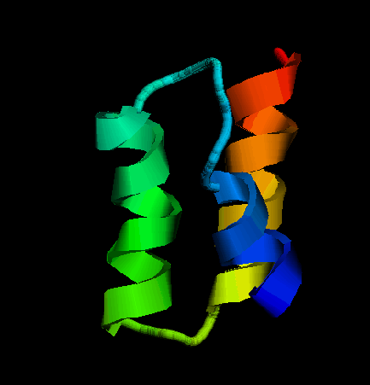
Protein folding problem #1
Amino-acid sequence – translated genetic code.
MET—ALA—ALA—ASP—GLU—GLU--….
How?
Experiment: amino acid sequence uniquely
determines protein’s 3D shape (ground state).
Nature does it all the time. Can we?

Slide 3
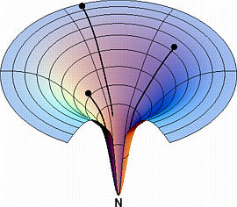
2
3
Free energy
1
Finding a global minimum in a multidimensional case is easy only when the landscape is smooth. No matter where you start (1, 2 or 3), you quickly end up at the bottom -- the Native (N), functional state of the protein.
Folding coordinate
Adopted from Ken Dill’s web site at UCSF

Slide 4
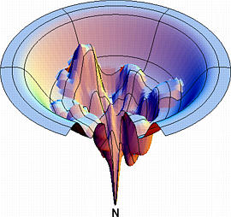
Realistic landscapes are much more complex, with multiple local minima – folding traps.
Adopted from Ken Dill’s web site at UCSF

Slide 5
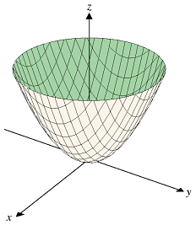
Additional complication: protein folding problem = highly constrained minimiazation
E(x,y,z) = x² + y² ⁺ z² – easy to solve. Min = (000).
Becomes much more complex if a complex constraint is added e.g. Sin²(x) + y + z = const.
In the case of protein folding, constraint comes from the specific amino-acid connectivity – beads on a string chain.

Slide 6
The magnitude of the protein folding challenge:
Enormous number of the possible conformations of the polypeptide chain
φ₄
φ₂
φ₃
φ₁
A small protein is a chain of ~ 50 mino acids (more for most ).
Assume that each amino acid has only 10 conformations (vast underestimation)
Total number of possible conformations: 10⁵⁰
Say, you make one MC step per femtosecond.
Exhaustive search for the ground state will take 10²⁷ years.
Why bother: protein’s shape determines its biological function.

Slide 7
Levinthal’s paradox:
How can proteins EVER fold, given their mind boggling complexity (that is the number of degrees of freedom that the folding protein needs to search through to find the minimum energy state).

Slide 8
Key points
A realistic scientific computation scenarios
No specific natural science background is expected: the minimum necessary will be given to you once you select your project.
Get a feel of what real computational science is, get exposed to all stages of a project.
Supercomputer on the desk.

