Slide 1
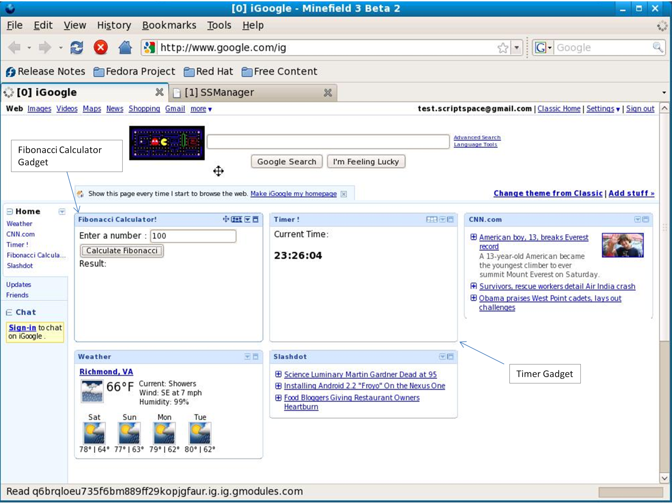
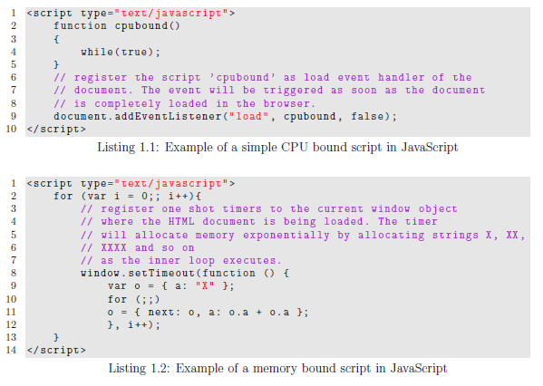
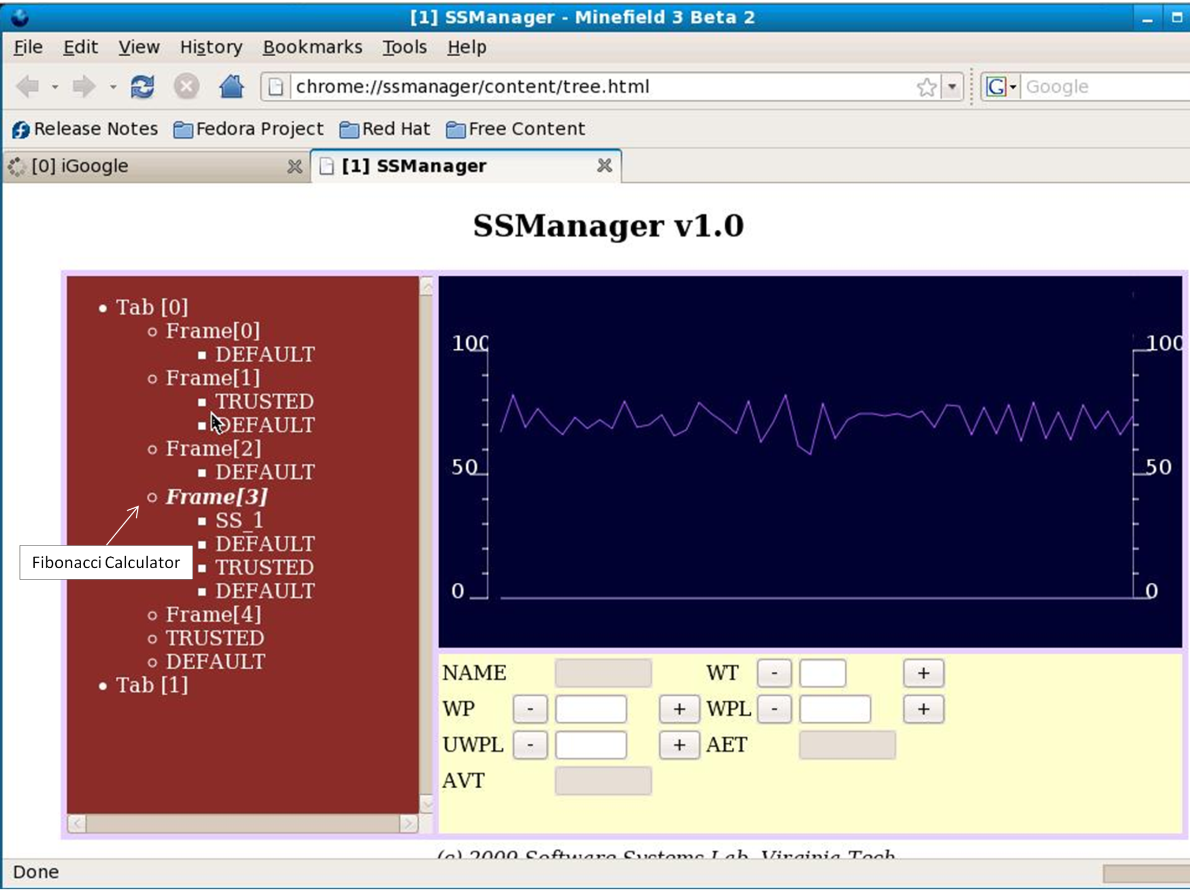


C
Fine-Grained JavaScript Execution Isolation Using Script Spaces
Amarjyoti Deka
Acision, Inc.
amar.deka@gmail.com
Godmar Back
Department of Computer Science, Virginia Tech
gback@cs.vt.edu
Motivation
Many emerging web/in-the-cloud applications rely on increasingly complex JavaScript components coexisting within one page:
Rich Internet Application (RIA)
frameworks; heavy use of JS libraries;
third-party ready-to-include
`widgets’
Client-side extensions (content scripts)
interact with arbitrary pages
Current JavaScript environments lack
namespace separation, fault and resource
isolation; malfunctioning or malicious
components affect entire page/tab and/or
browser
Need for robust execution environment
Multi-process browsers provide partial solution: do not provide isolation below the level of individual tabs/pages and move resource management problem to underlying OS, which often lacks information about appropriate resource management strategies
C
C
C
Script Spaces/DOM Relationship:
By default, each page executes within its own Script Space, but Script Spaces may also be created for portions of a page corresponding to sub trees of the DOM tree.
Mash-Up Example:
This iGoogle mash-up includes a CPU bound gadget (Fibonacci); using Script Spaces, the page remains responsive and other gadgets remain functional even when it is run.
Script Spaces
Provide an abstraction for separate execution of JavaScript code components
Key features:
  Unit of isolation
  Configurable namespace
  Separately schedulable
  Separate termination
  Separate resource accounting
  Shared access to DOM
  Backwards-compatible (within each space, a single-threaded environment; respects DOM event processing semantics)
Related work:
  Orthogonal to work directed at improving security models or implementations (Caja, ConScript, etc.)
  Design alternative to multi-process model
  Complementary to emerging parallel browser implementations
Implementation
Prototype based on
Firefox 3.0b2 codebase/
Spidermonkey VM
Uses SM contexts to
manage multiple
JavaScript execution
contexts simultaneously
No static binding
between threads and
script spaces
“Migrating threads”
enter and leave spaces
based on event processing needs
CPU scheduling via interpreter hook (branch callback)
Implements Borrowed Virtual Time [Duda99] scheduler
Includes component-based management interface and UI for user interaction/adjustment
Current limitations: not parallel; Firefox components aren’t thread-safe; memory accounting not implemented
C
Script Space Manager:
An extension displays existing script spaces and CPU consumption over time; users can adjust consumption of spaces or terminate them safely.
C
This work was partially
funded by NSF CAREER
Award CISE/SHF #0845830

