Slide 1
Observer Pattern
Justin Siu, Jacob Searles,
John Nguyen,
Weihao Gao, Weikai Liang
Notes:
Jacob

Slide 2
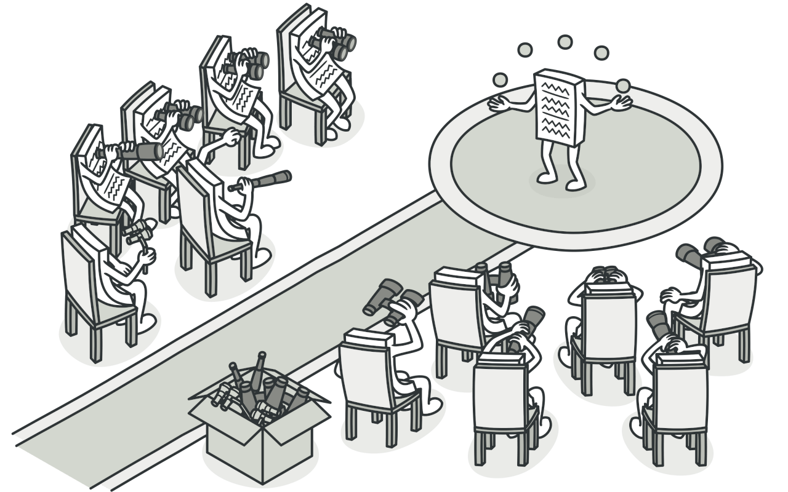
What is the Observer Pattern?
It is a behavioral design pattern that lets you define a subscription mechanism to notify multiple objects about any events that happen to the object they’re observing
Notes:
Jacob

Slide 3
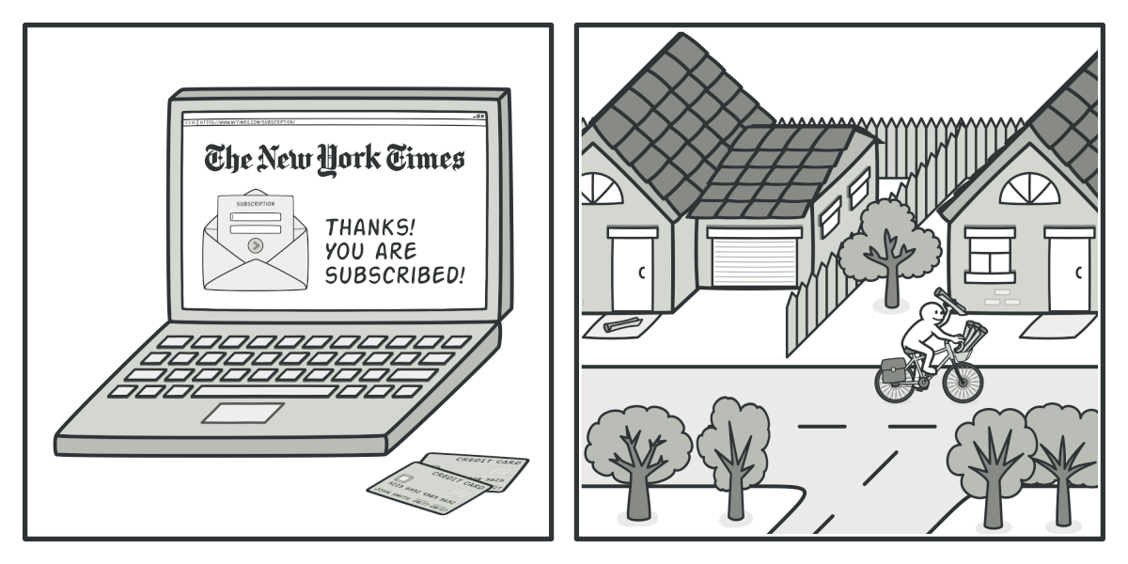
Analogy
Subscribing to a magazine/newspaper
Notes:
Jacob

Slide 4
Important Terms
Subject / Publisher
The object with some data of interest that will be notifying our subscribers of changes
Observer / Subscriber
All other objects that want to track the changes in the publisher
Subscribe / register / attach
Observers register themselves to the subject because they want to be notified when there is a change
Notify
The subject pushes data to the observers
Notes:
Jacob

Slide 5
Problem it solves
Defining a one-to-many dependency between objects without making the objects tightly coupled.
Ensuring when one object changes its dependencies change as well
It should be possible that one object can notify an open-ended number of other objects
Notes:
Jacob

Slide 6
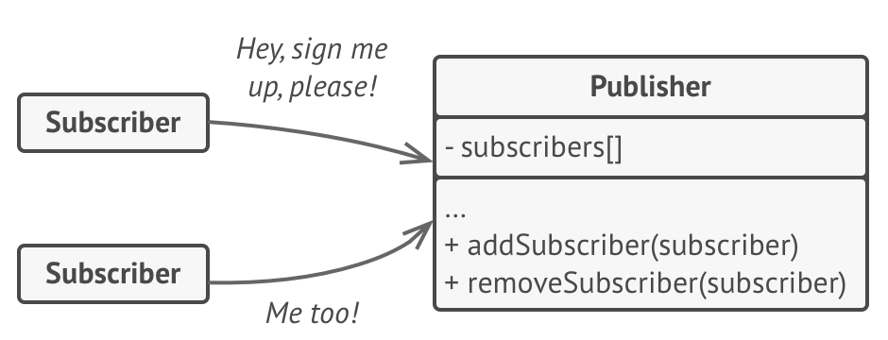
Adding and removing subscribers
Notes:
John

Slide 7
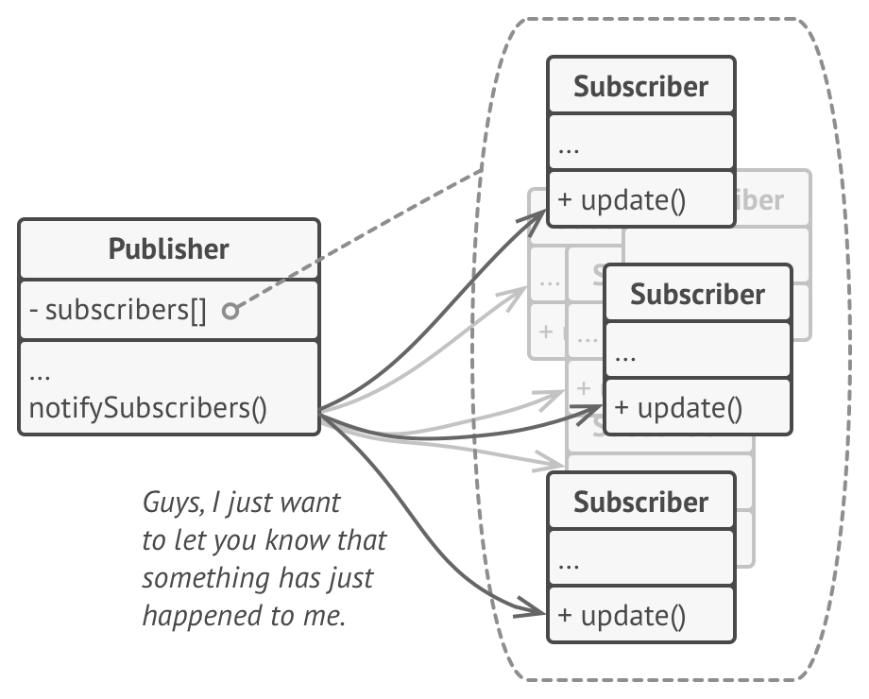
Notifying subscribers
Notes:
John

Slide 8
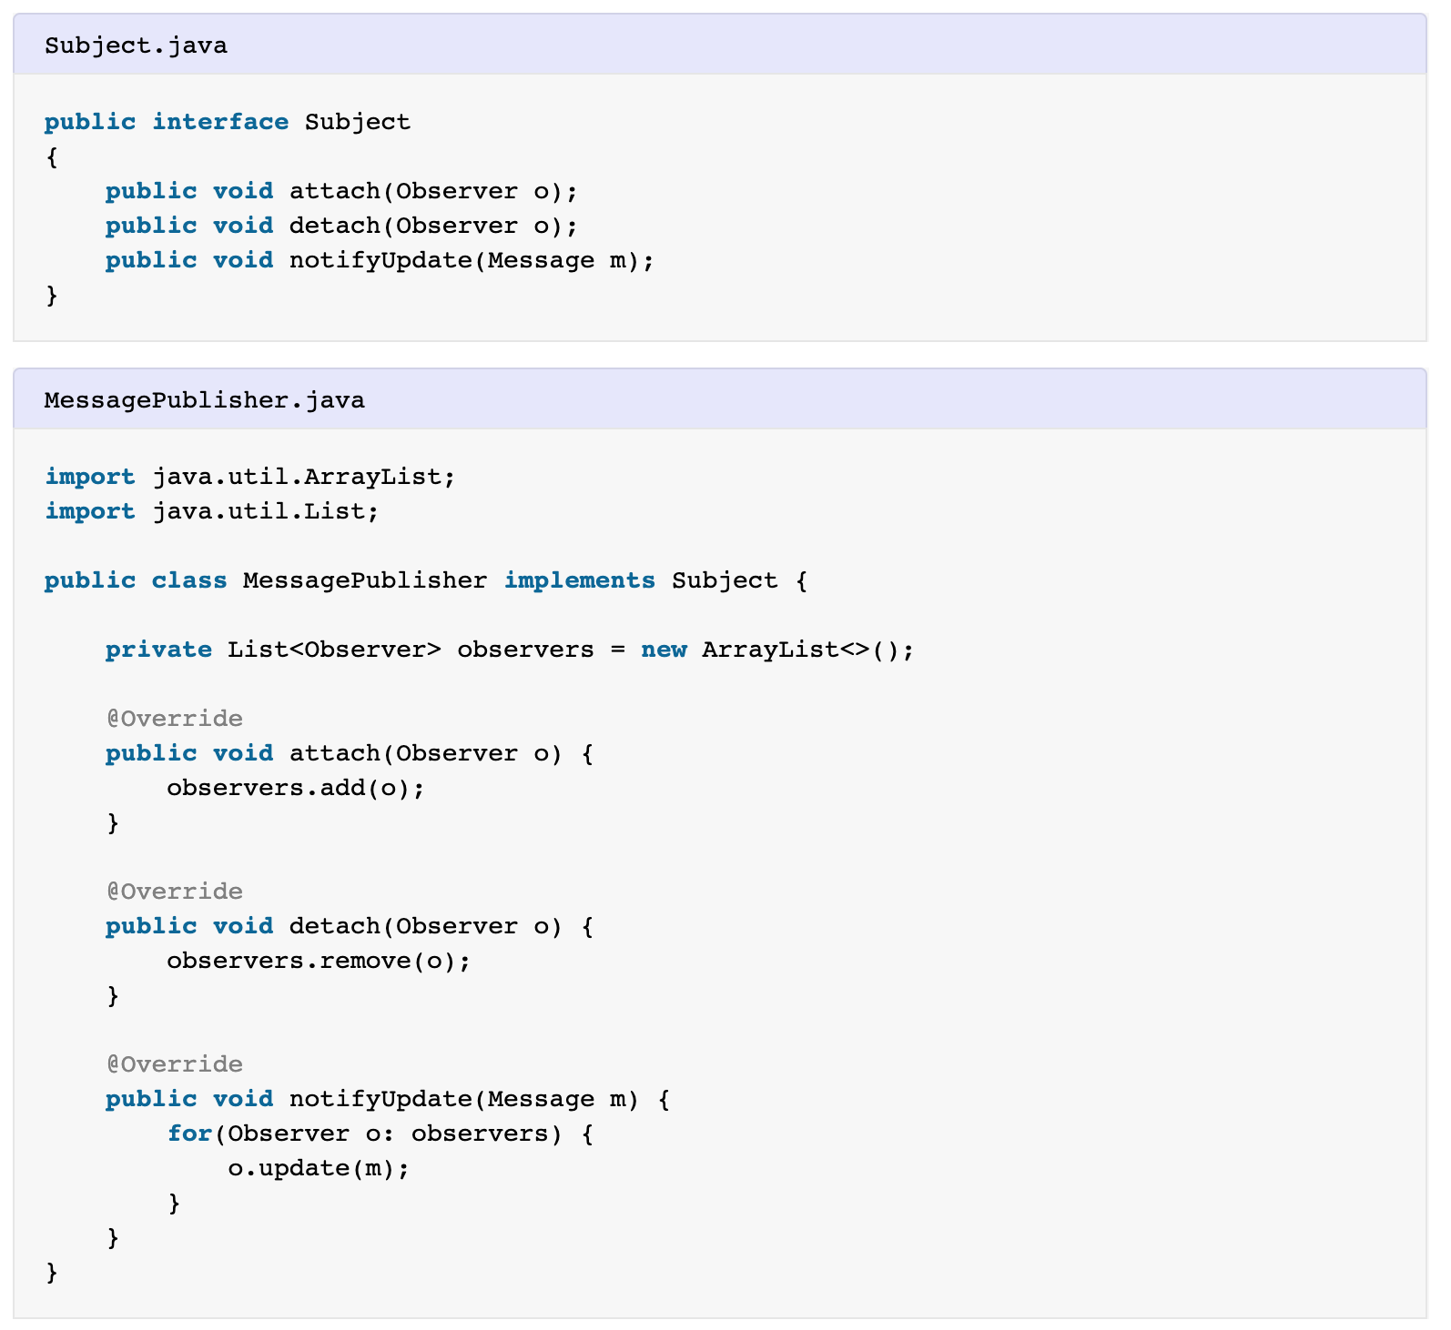
Java Example
Notes:
Weihao

Slide 9
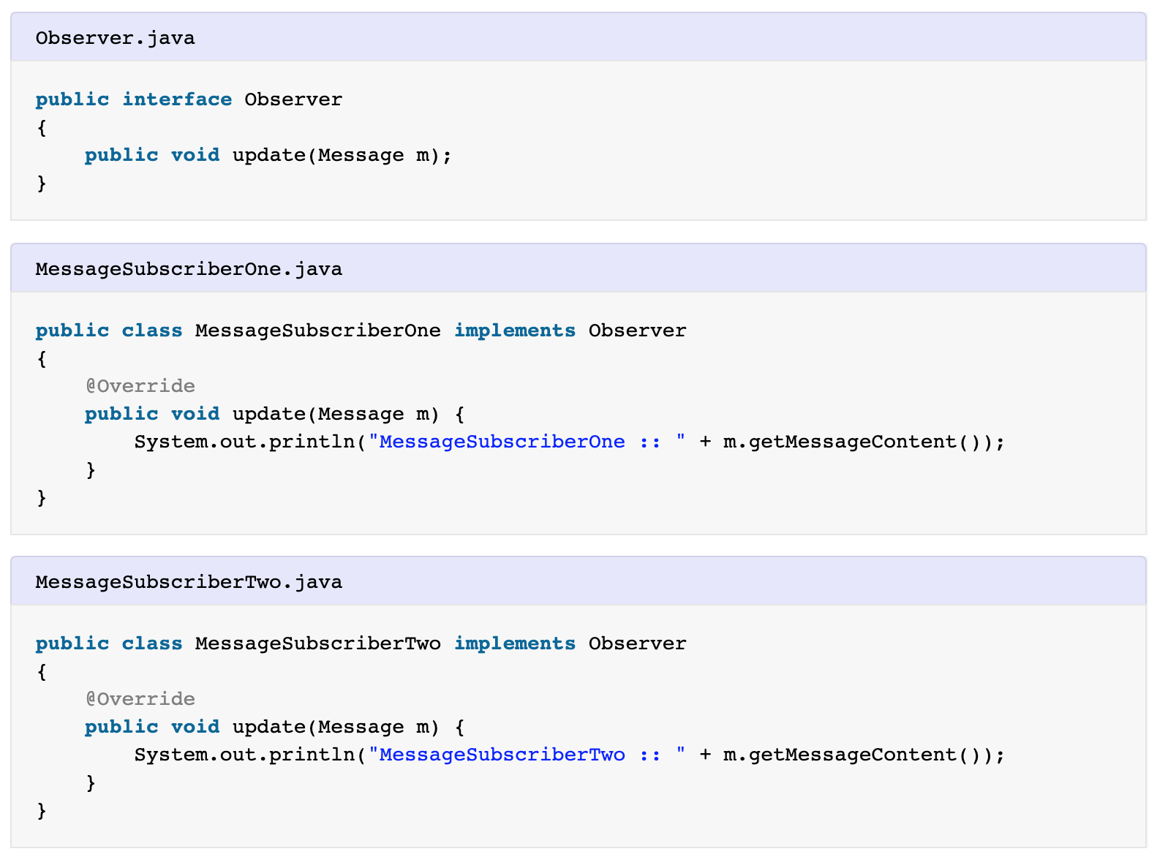
Java Example
Notes:
Weihao

Slide 10
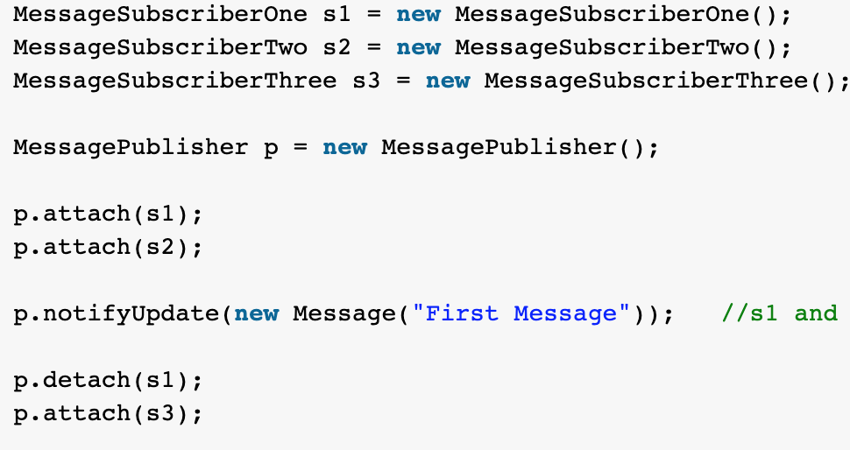
Java Example
Notes:
Weihao

Slide 11
Example1: Social Media Feed
Following someone on Instagram
An observer is attached to that person(subject/publisher)
The account has the one-to-many relationship with its followers and has virtually no limit to the amount of followers
The followed account makes a post
All observers(followers) are notified and then update their feeds respectively
Unfollowing
The observer is detached and will no longer receive updates from the publisher

Slide 12
Example2: Instant Messaging
Users(2 or more) are added to a chat
Each user then subscribes an observer to the messaging feed
Probably notifies existing subscribers a new user has joined
A user sends a message to the chat
Every subscribed user is then notified that a new message was sent
Each user then draws the message on their client
User(s) leave the chat
Leaving a chat unsubscribes the user’s respective observer and will no longer receive updates
Maybe even notifies others that the user has left

Slide 13
Can you think of any real world software examples?

Slide 14
Sources
https://refactoring.guru/design-patterns/observer
https://medium.com/datadriveninvestor/design-patterns-a-quick-guide-to-observer-pattern-d0622145d6c2
https://en.wikipedia.org/wiki/Observer_pattern

