Slide 1
MVC Architecture
Edward Liu
Tim Nguyen
Nathaniel Salazar
Nabdeep Shrestha

Slide 2
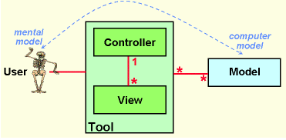
Who (History)
Background Before
Human (Mental) Model vs Computer’s (Digital) Model
How to bridge the gap?
Invention - 1978
Trygve Reenskaug at Xerox Palo Alto Research Center
Solve problem of representing (modeling) complex real-world systems
Notes:
Before we dive into what exactly MVC is, I want to talk a little about the history behind MVC.
Before, programmers would have two separate models; one that humans can understand for a process, and a digital model that computers could understand. The problem with this two-model system is that there is a gap between them in order to translate from one to another.
There wasn’t any pre-existing concept or pattern that bridged the gap between the two models. That is, until 1978, where Trygve Reenskaug wrote a paper introducing the concept of MVC. He made this in order to solve the problem of representing complex real-world systems, and would become one of the most popular patterns to adhere to for software engineers.

Slide 3
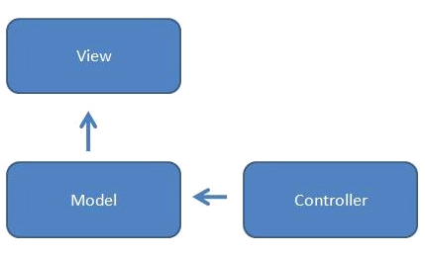
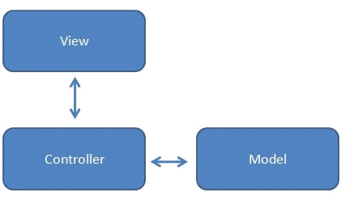
Who (History Cont.)
Initial Use
Architectural pattern for GUIs
Separated Presentation
Evolution
Various changes to pattern based on new technologies
Separation of Concerns
Notes:
MVC itself has gone through some various evolutions and changes in its definitions and layouts. Initially, the pattern was used for GUIs, but would exhibit a principle called separated presentation. This means that all code that manipulates presentation, only manipulates presentation. This pushes all domain and data source logic to its own modules, in separate areas of the program.
As we can see by the figure on the left, it is a very linear, one-way layout of interaction between the 3 modules of the program. The controller never really interacts with the view directly; any changes the controller does to the model, the model will then be in charge of updating the view in reaction to it.
Throughout the development and innovation of different technologies, the MVC model has changed and evolved over time, until eventually it became what we know it as today.
This evolved, modern MVC model exhibits a principle called a separation of concerns, which is similar to separated presentation in that each module is divided based on their function, but it also allows for the cross-communication between them.
As seen on the figure on the right, the controller is now the “middle-man” of the model; with the ability to communicate with both the view and the model. Any changes the view does, its reflected to the controller, which can then change the model, and vice versa. This modern model of MVC allows for more communication, and stemmed from years of technological innovation.

Slide 4
What (Technical Details)
Model: Data flow or business logic
View: What users interact with
Controller: How user’s actions are handled based on the model
Software design pattern for web applications, specifically, a 3-layer architecture.
Example: M: Database, V: Web template, C: URL dispatcher

Slide 5
When (Scenarios to Use)
Web Application Development
Able to separate development into
Business Logic (Model)
UI (View)
Input Logic (Controller)
Need separate views for different types of users
Future modifications
Notes:
You often see the MVC architecture used in web application development. MVC was developed as a pattern to easily display information to users.
With the visual-driven tool that is the internet, MVC allows the front-end to be developed along side the back-end to ensure that there wasn’t a heavy dependence on the other and change when necessary.
Another benefit is that the development team can divide up work based on those working on business logic, the user-interface, and the input logic. If one portion of the program changes at a faster pace than the other such as constantly updating the style of web page vs the function of the website, then teams can easily shift priorities based on availability.
Finally, to accommodate different users, each model can each have their own separate view. So for example, the vendors can view statistics of their products while customers simply see lists of the vendor’s products when they visit the same web page.
So in short, if you’re developing a product that is intended for the web and you need to easily modify the user interface, then the MVC architecture is the way to go.

Slide 6
Where (Prominent Examples)
Django
Python-based free and open-source web framework
Rails
Ruby-based server-side web application framework
Notes:
Some prominent examples of where MVC is used is with 2 popular web frameworks: django and rails
Django is an open-source web framework written in python while Rails or Ruby on Rails is a server-side web application framework written in Ruby

Slide 7
MODEL | View | Controller
Object-relational manager Relational database | Web templating system | Regular expression based URL dispatcher
Table in database Customer.rb file | Customer.erb file | Determines which view file to render Query models
Notes:
Django - https://en.wikipedia.org/wiki/Django_(web_framework)
The model is both an object-relational mapper that mediates between data models along with relational database
The view is a web templating system that is part of a system for processing HTTP requests
The controller is a regular-expression-based URL dispatcher
Ruby on Rails - https://en.wikipedia.org/wiki/Ruby_on_Rails
The model is mapped to a table in a database along with an associated Ruby file. So a model class Customer correlates to a customer.rb in the project directory and a table titled customers is created in the database.
The view in this case is stored as an erb file which is able to be evaluated and converted to HTML at run-time.
The controller is how Rails responds to external request from the web server to the application by determining which view file to render and querying models for information to pass to those views.

Slide 8
Why (Comparison between other models)
Model View Controller | Model View Presenter | Model View ViewModel
Model | Model | Model
View - presentation and rendering | View - presentation and rendering | View - presentation and rendering
Controller Handles data sent by user Determines which View is returned | Presenter Addresses UI events that occur in the View Simply displays data through View instead of returning the View | ViewModel Allows Model and View to communicate directly Similar to Presenter Supports two-way data binding
Notes:
MVC has been widely popular since its introduction, which has spawned some newer patterns that resemble it. As you can see, there is the Model View Presenter and Model View ViewModel architectures. The Model View Presenter architecture incorporates a little bit of event driven programming in which the Presenter addresses UI events that occur in the View and returns the data accordingly. The Model View ViewModel architecture is similar to the MVP architecture except it also supports 2 way data binding. There are other variations of MVC, but this shows that it is also adaptable to fit certain requirements.

Slide 9
Future of MVC
With the rise of Microservice architecture, the traditional 3 tiered architecture approach is being used less
Microservice architecture provides more scalability and each service can be changed independently without breaking the other
MVC - more simple, better for smaller applications
Might be suitable for startups
Not as complex to set up
As company grows, microservice architecture becomes more advantageous
Notes:
Lately, 3 tiered patterns have been used less frequently with the rise of cloud computing and microservice architecture. Microservice architecture utilizes independently deployed services that work together for a common purpose. The main benefit of it is that it provides much more scalability than the monolithic 3 tiered design, and it makes testing easier as each service can be tested and updated without worrying about how it affects other services, where as a change in one of the application tiers would require testing of the entire tier. This does not mean that MVC has no advantages of its own; MVC requires much less overhead in terms of setting up at the beginning and it’s much more simple design in general, which makes it more suitable for smaller projects and startups. However, as a startup company grows, microservice architecture becomes more advantageous.

Slide 10
Sources
https://towardsdatascience.com/10-common-software-architectural-patterns-in-a-nutshell-a0b47a1e9013
https://medium.com/@socraticsol/why-mvc-architecture-e833e28e0c76
https://www.tutorialsteacher.com/mvc/mvc-architecture
https://www.tutorialspoint.com/struts_2/basic_mvc_architecture.htm
https://academy.realm.io/posts/eric-maxwell-mvc-mvp-and-mvvm-on-android/
https://gautambiztalkblog.com/tag/microservices-approach-vs-traditional-approach/

Slide 11
Questions?

