Slide 1
Home Security System Compromised by a $2 Wireless Emitter
Group 4: Yusheng Cao, Rob DeGrandis, Jeanie Lam, Owen McGee, Weijiang Pan
Notes:
https://www.theverge.com/2019/8/7/20758529/simplisafe-home-security-system-flaw-compromise-lockpickinglawyer

Slide 2
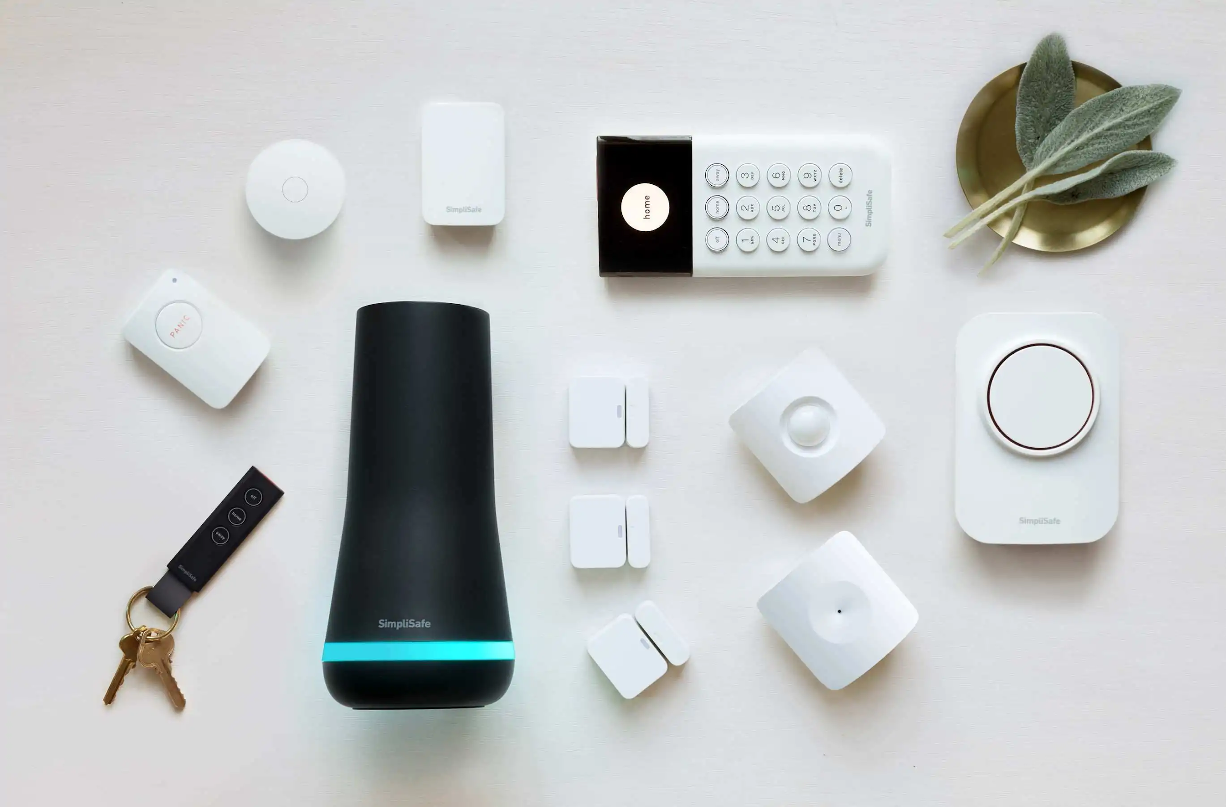
SimpliSafe Home Security System
SimpliSafe is a plug & play Home Security System
Wireless
Operates on common radio frequency for low powered devices

Slide 3
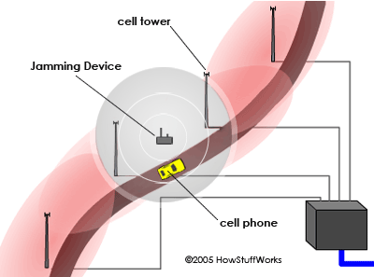
Why this is a problem?
Radio Interference
Easily Jammed
Baby Monitors
Garage Door Openers
Car Keys
Headphones
Remotes

Slide 4
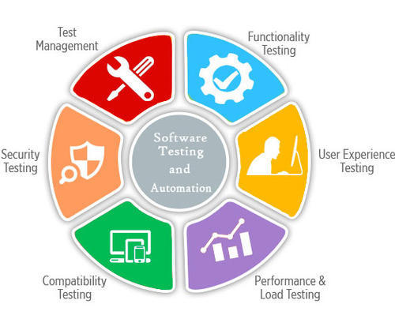
How this relates to software engineering?
Proper Testing
Testing in Realistic Scenarios
Infinite Edge Cases
Notes:
We all know how to write basic test cases, but at the end of the day all that does is test the actual software and only the inputs that we can come up with and cases we can reasonably think of. Real life is much more random and unpredictable than anything a single software engineer or a team of engineers can think of. We will never be able to cover every edge case so we just need to focus on covering as much as possible. That being said this problem should have been found through testing in realistic scenarios. Before shipping a product like this especially one that has to do with home security the company should have done extensive testing with as many edge cases they could think of. We also believe that the hardware engineering team and the software engineering team did not communicate enough when designing the system or did not run their tests together but instead ran them separately and made assumptions based on what the other team would do.

Slide 5
Possible Solutions
Extensive Real Life Testing
Change the System to have a Stronger Broadcast
Use a Less Common Frequency
Notes:
As we just discussed one way this problem could’ve been discovered is through extensive real life testing, however all this would have done is discover the problem so a couple ways to actually fix this problem is to give the transmitter a stronger broadcast one way this can be done is by broadcasting to all the other transmitters in the house so they can then all transmit together in an effort to overpower whatever is causing the interference. Another way to combat this is to use a less common frequency as Rob discussed earlier the radio frequency that is being used here is very common in many different low powered devices so in order to avoid ruining this system with such ease they could have used a frequency that is less common.

Slide 6
?
What are ways SWEs can stay grounded when designing software?
How can we avoid over engineering solutions to problems?

Slide 7
Questions?

