Slide 1
The Command Pattern
Group 2
Jessie Butler, Anthony Farina, Andrew Jorquera, Niles Rogoff, Andre Urcia

Slide 2
The Command Pattern
Definition: The command pattern encapsulates a request as an object, thereby letting us parameterize other objects with different requests, queue or log requests, and support undoable operations.
Simpler definition involves 4 aspects:
Command - have a command interface; any new commands you want to add will implement this interface (Ex. light on, light off)
Receiver - the object that will be receiving the commands (Ex: the light bulb)
Invoker - keeps track of all registered commands for the receiver(s) (Ex. the light switch)
Client - decides when and which commands to invoke for the receiver (Ex: person who turns on the light switch)
Source: https://www.geeksforgeeks.org/command-pattern/
Notes:
Jessie

Slide 3
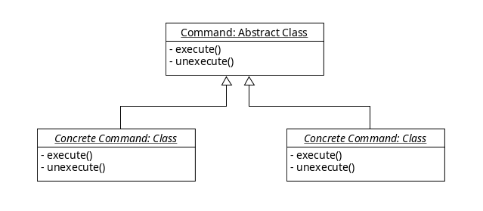
Feasibility, domain knowledge, responsibility separation
The Command pattern allows for separation of concerns
The UNDO system does not need to know what action it is undoing
All commands implement a simple Abstract Base Class (ABC) with two virtual methods
Dependency Inversion Principle (SOLID)
Notes:
Andre

Slide 4
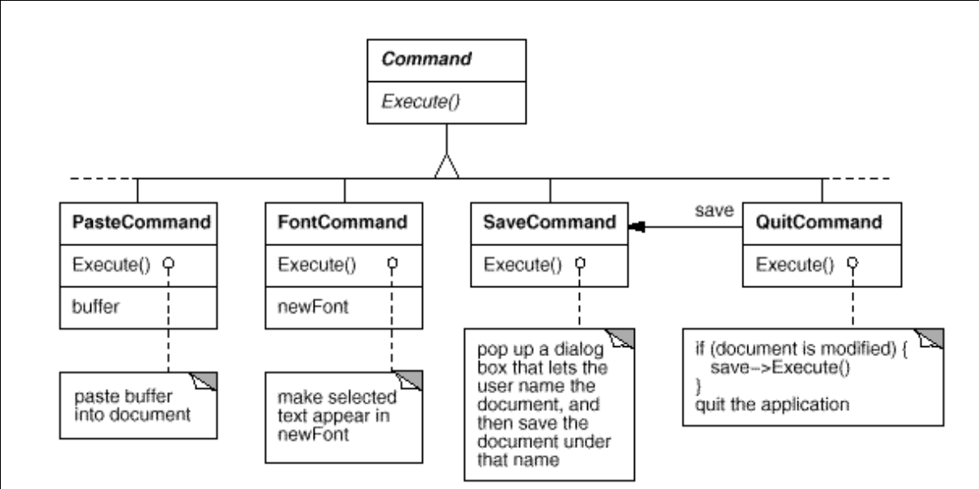
Undo Example
Notes:
Anthony Farina

Slide 5
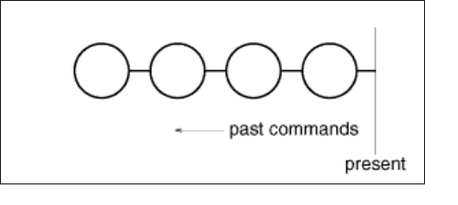
Undo Example
Notes:
Niles

Slide 6
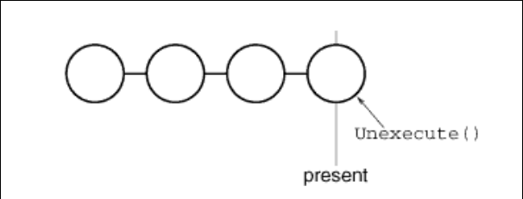
Undo Example
Notes:
Niles

Slide 7
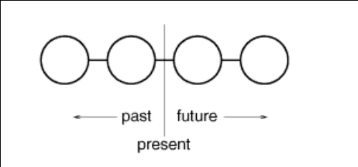
Undo Example
Notes:
Niles

Slide 8
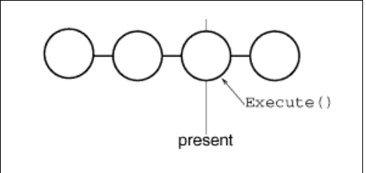
Undo Example
Notes:
Niles

Slide 9
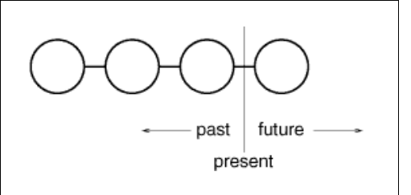
Undo Example
Notes:
Niles

Slide 10
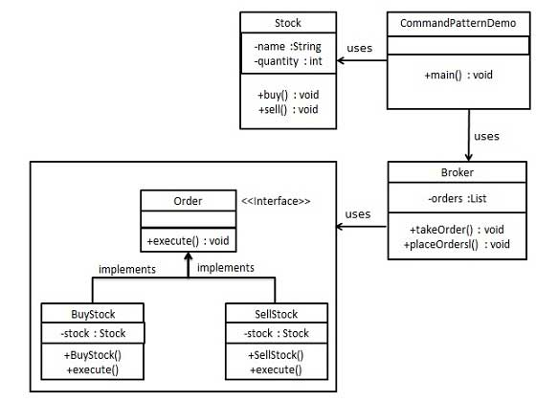
Command Pattern in Use
An example of the command pattern can be seen in stocks. A “broker” class can invoke a buy or sell “order”
Another example comes from download wizards. When the “Next” button is pressed, the wizard executes a command object to start the next step of the configuration.
Finally, in a text-editing application, each menu item can have a command
https://www.tutorialspoint.com/design_pattern/command_pattern.htm
Notes:
Niles

Slide 11
More uses
Database Transactions
unexecute() to roll back transaction
Multiplayer Games
Command implements Serializable -> send to other players to execute
Thread pools
Submit Commands to the thread pool to be run
Macro Recording
Similar to undo log, with replayability
Notes:
Andrew

Slide 12
There are three main types of design patterns: Creational, Structural and Behavioral.
Despite having lots of structure, the Command pattern is a Behavioral design pattern. Why do you think this is?
Notes:
Niles

Slide 13
Questions?

