Slide 1
Big Data Monetization Business Model
Danya Shere, Grayson Stone, Andrew Solomon, Sparsh Srivastava
Notes:
Grayson

Slide 2
What is Big Data?
Data that is so large that it is difficult or impossible to process it using traditional methods
The V’s
Volume - data is collected from a large amount of sources (business transactions, social media, smart devices, etc). Storage used to be an issue but platforms like data lakes have helped to make this less of a problem.
Velocity - with the growth of IoT, data streams into businesses at unprecedented speeds and needs to be handled in a timely manner
Variety - data comes in many formats (structured in traditional databases or unstructured as documents, audio, emails, etc)
Notes:
Danya

Slide 3
What is Big Data, cont.
The V’s, continued
Value - Due to the large amount of data and limited storage capacity, the data being stored must have some inherent current or future value to justify the storage space resources it occupies.
Veracity - Data can be robust, therefore only the relevant sections should be stored, which implies removing unnecessary noise or biases.
Variability - The structures for data collection and data storage must be flexible and adaptable to be able to function and prosper under unpredictable circumstances.
Notes:
Danya

Slide 4
Common Big Data Use Models
Return on Advantage Model:
Organizations will use internal performance data or demographic data to formulate advantages for the efficiency of their business processes. For example, this often involves consumer targeting or risk mitigation/fraud detection.
Premium Service Model:
Providing additional analytics directly to consumers, utilizing the Software as a service (SaaS) model. For example, Apple’s health analytics and fitness monitoring, provided to the user.
Notes:
Sparsh

Slide 5
Common Big Data Use Models
Differentiator Model:
Used to create brand loyalty, by leveraging data regarding the loyalty of a customer/user to provide additional services and incentivise these users to remain with the brand. For example, hotel points or travel points for customers who maximize the use of their product.
Syndication Model:
Raw collected data is transformed, in order to be useful to third parties. The third parties can set up a syndication data feed, or delivery channel API, to receive a constant stream of data. This model can be seen by Facebook, Twitter, and many others public APIs.
Notes:
Sparsh

Slide 6
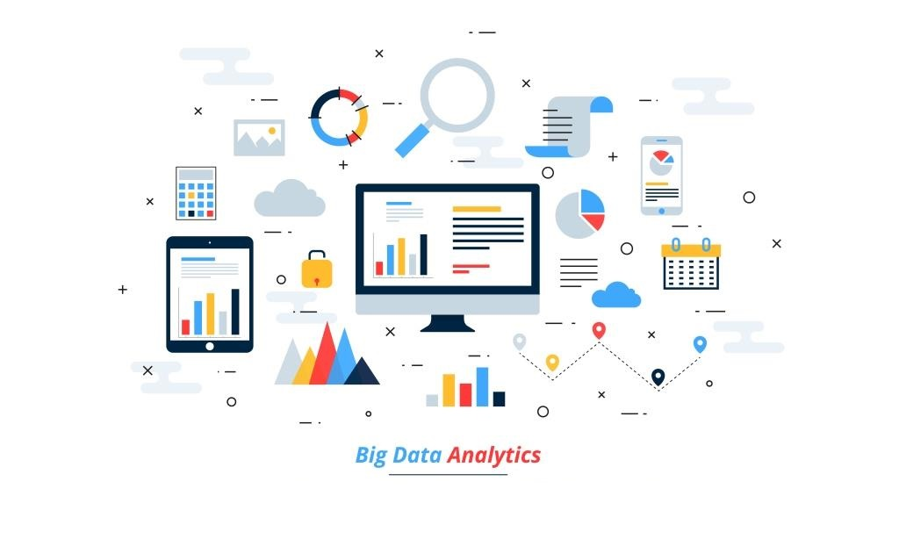
How is Big Data Monetized?
Big Data is Monetized in 3 main ways:
Utilizing data to increase consumer relevance and convenience
Repackaging and selling specialized data
Enhancing delivery channels for data
Notes:
Grayson

Slide 7
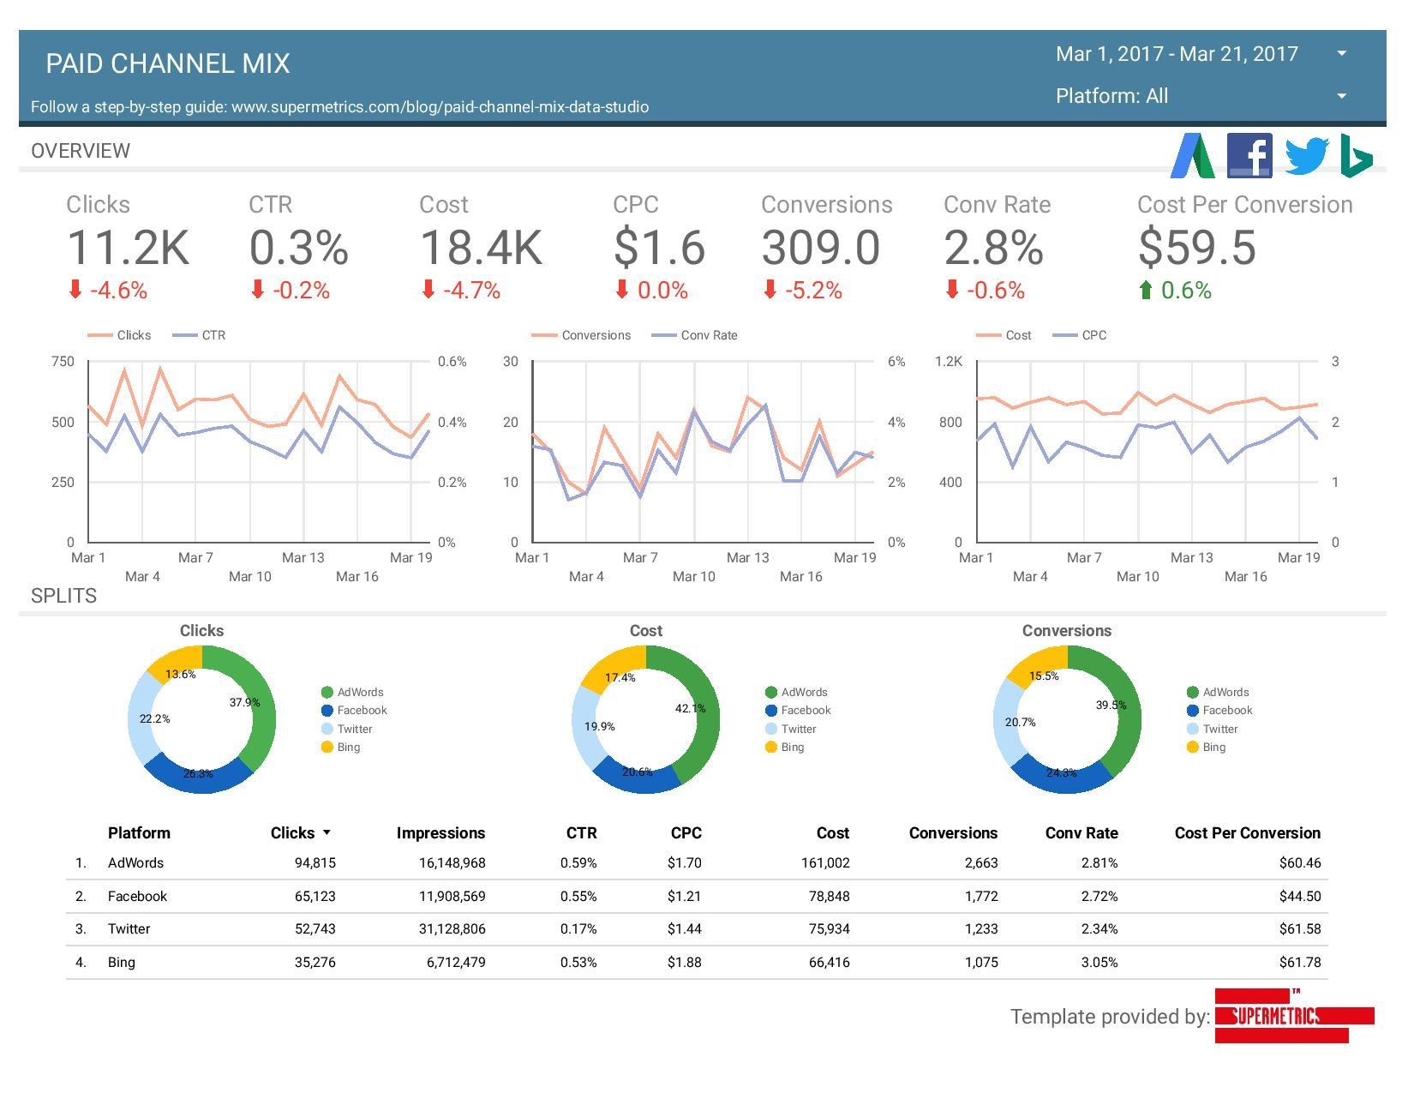
How to Monetize Relevant Data to Consumers
The first model is all about using big data to offer an increased and more relevant experience to a user by determining which pieces of data are important to them
Google Adsense
Using user data to cater adds more effectively
Increasing value of ads to buyer by increasing effectiveness of ads
Maps package tracking
Using data to enhance customer experience
Selling data to shipping companies to enhance user satisfaction
Notes:
Grayson

Slide 8
Monetizing Repackaged Data
The second model relies on combining big data to isolate very particular data sets in order to have more relevance and allow for specialized use
Wall Street Private apis
Using both public and private datasets to repackage and sell new increasingly specific data
Consumed in an attempt to determine some way to increase profits
New analytics to aid in consumer behavior
Repackaged data can be sold to consumer facing companies to predict consumer behavior
Increasing ad relevance based on new metric
Improving user experience
Notes:
Sparsh

Slide 9
Monetizing Data Delivery Channels
Increasing ubiquity of computers requires increased ways to deliver relevant data along with channels that can handle higher load
Often APIs allow certain limited request amount for free, however, as requests increase your cost increases.
Can use this method to scale revenue based on access
Cloud services can allow for scalable hosting of APIs based on given demand
Can also offer storage for larger data sets
AWS, Azure, Google Cloud
Notes:
Grayson

Slide 10
Interesting Problems on the Horizon
Most data consumer data is presented in an anonymized fashion. Presented in a way to hide user data.
Much of this data can actually be de-anonymized or “re-identified” so companies could theoretically use what was supposed to be private data.
How will large datasets be handled in the future?
Will things like GPDR(General Data Protection Regulation aka the reason why sites make you acknowledge cookies) affect how future software engineers treat personal data?
Notes:
Andrew

Slide 11
Questions?
Notes:
Andrew

