Slide 1
State Design Pattern
Brandon Jacobsen

Slide 2
State Pattern
Problem: An object has many different behaviors depending on its internal state. The object must be able to change its behavior during runtime depending on the current state that it is in.
Solution: We build a framework that keeps track of the program or object’s current state. Depending on what this current state is, the program or object’s behavior will react accordingly.

Slide 3
Core Classes
State Class
Abstract class that all concrete state classes should subclass from
Example functions:
OnEnter()
OnExit()
Update()
Concrete State Class
Implements the true functionality that is desired
Several of these classes for each program or object that implements this pattern
State Machine (Optional)
Handles the overall functionality of managing current state and state changes

Slide 4
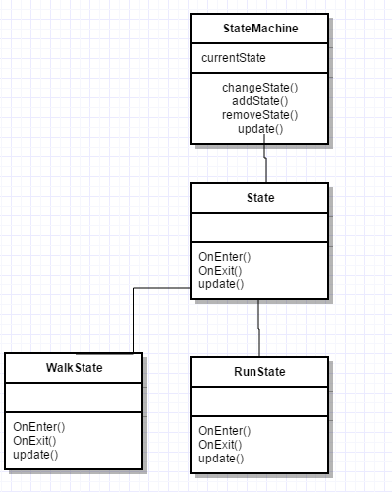

Slide 5
Common State Pattern Uses
Process Scheduling/Orchestration
Artificial Intelligence
Game Engines

Slide 6
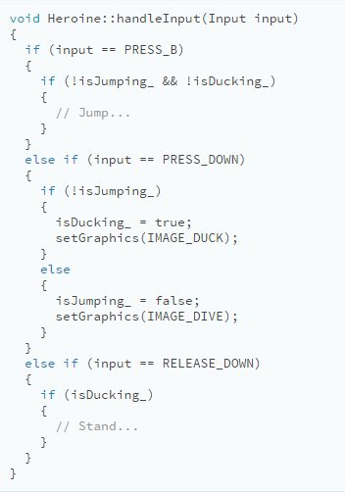
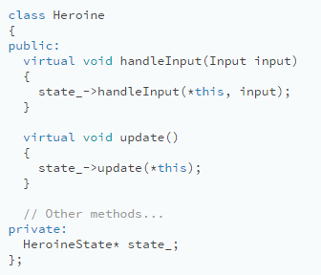
Code Example
http://gameprogrammingpatterns.com/state.html

Slide 7
Pros and Cons
Pros:
Removes the needs of large conditional statements
Simple to implement and an easy way to manage a program or object’s behavior.
Quick and easy to add new behaviors
Encapsulates data
Cons:
Can be hard for a new programmer touching the code base to understand what all the states are doing.
Requires clean and informative documentation to keep track of behaviors.

Slide 8
Key Points
The state design pattern is simple to implement
Solves the problem of managing behaviors
Can be used in several scenarios
Leads to easier to read code and better data encapsulation.
Despite these benefits, requires in depth documentation to keep track of behaviors and make it easier for new programmers to understand your intentions when they join the team.

