Slide 1
Singleton design pattern
Nima Yahyazadeh

Slide 2
Intent
Only one instance
Providing global point of access
Just-in-time initialization or
Initialization on first use

Slide 3
How?
A single class responsible for:
Creation
Initialization
Access
Enforcement
Private static data member
Provide public static function
Client calls accessor function

Slide 4
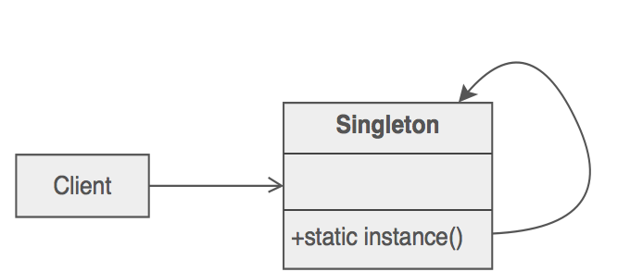
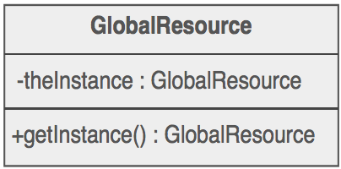
How?
Initialization on first use

Slide 5
Java Code
public class Singleton {
// Private constructor prevents instantiation from other classes
private Singleton() {}
/**
* SingletonHolder is loaded on the first execution of Singleton.getInstance()
* or the first access to SingletonHolder.INSTANCE, not before.
*/
private static class SingletonHolder
{
private static final Singleton INSTANCE = new Singleton();
}
public static Singleton getInstance()
{
return SingletonHolder.INSTANCE;
}
}

Slide 6
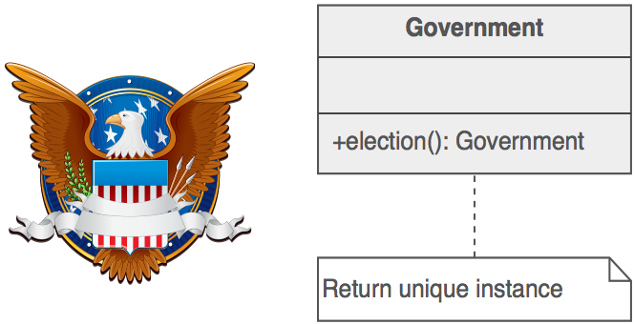
Office of the U.S president
Only one president at a time
Global point of access
Regardless of president name

Slide 7
Ideas
Initialization and global access
Can we extend it?
Singleton and subclasses
Deleting object a singleton pattern

Slide 8
Sources
sourcemaking.com/design_patterns/singleton
sourcemaking.com/design_patterns/to_kill_a_singleton
http://apachetechnology.in/ati/www/KC/dw/Design%20Patterns%20Explained.pdf

