Slide 1
Refactoring
Change value to reference
Substitute Algorithm
Replace conditional with polymorhpism

Slide 2
Substitute algorithm - Motivation
String foundPerson(String[] people){ for (int i = 0; i < people.length; i++) { if (people[i].equals ("Don")){ return "Don"; } if (people[i].equals ("John")){ return "John"; } if (people[i].equals ("Kent")){ return "Kent"; } } return ""; }
What’s Wrong?
Hard to read
Tedious to Modify
Lengthy

Slide 3
Substitute algorithm - Example
String foundPerson(String[] people){ for (int i = 0; i < people.length; i++) { if (people[i].equals ("Don")){ return "Don"; } if (people[i].equals ("John")){ return "John"; } if (people[i].equals ("Kent")){ return "Kent"; } } return ""; }
Benefits:
Shorter
Easier to Read
Add people by changing list
No need to change control
String foundPerson(String[] people){ List candidates = Arrays.asList(new String[] {"Don", "John", "Kent"}); for (int i=0; i<people.length; i++) if (candidates.contains(people[i])) return people[i]; return ""; }

Slide 4
Change value to reference - Motivation
Classes
Problems
class Customer { public Customer (String name) { _name = name; } public String getName() { return _name; } private final String _name; }
Each new order creates a new customer object
Each customer can have many orders
A lot of wasteful storage
Client Code Example
private static int numberOfOrdersFor(Collection orders, String customer) { int result = 0; Iterator iter = orders.iterator(); while (iter.hasNext()) { Order each = (Order) iter.next(); if (each.getCustomerName().equals(customer)) result++; } return result; }
class Order... public Order (String customerName) { _customer = new Customer(customerName); } public void setCustomer(String customerName) { _customer = new Customer(customerName); } public String getCustomerName() { return _customer.getName(); } private Customer _customer;

Slide 5
Change value to reference - Example
Load customers from DB in advance
private static Dictionary _instances = new Hashtable();
Use a hash table to store/retrieve customers
Private constructor to disallow new customer creation
Factory method to handle customer creation
SHOULD be from DB
explicit code for example
Store existing customers in hashtable
Return the instance (reference) of customer with “name”
class Customer...
private Customer (String name) { _name = name; } static void loadCustomers() { new Customer ("Lemon Car Hire").store(); new Customer ("Associated Coffee Machines").store(); new Customer ("Bilston Gasworks").store(); } private void store() { _instances.put(this.getName(), this); }
public static Customer getNamed (String name) { return (Customer) _instances.get(name); }

Slide 6
Change value to reference - Benefit
class Order { public Order (String customer) { _customer = Customer.getNamed(customer); }
Customer class can reference existing customers
Many orders can reference the same customer
If a customer has a data change, the orders will not have to get new data or create new data. The referenced object changes for the orders

Slide 7
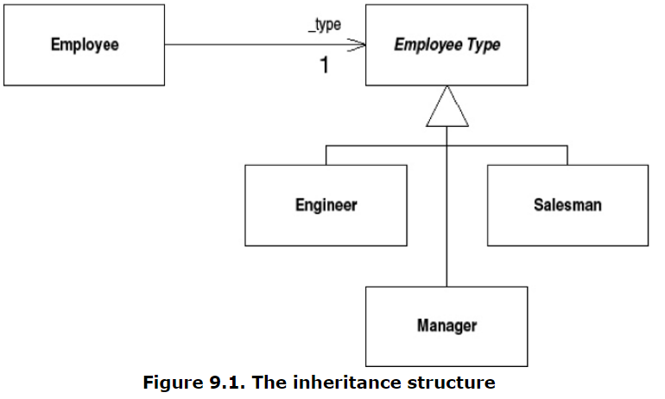
Replace conditional with polymorphism - motivation
Avoid writing an explicit conditional when you have objects whose behavior varies depending on their types.
If you want to add a new Employee Type subclass you have to find and update all the conditionals
Avoid high coupling between Employee Type and sub classes

Slide 8
Replace conditional with polymorphism - Example
class EmployeeType... int payAmount(Employee emp) { switch (getTypeCode()) { case ENGINEER: return emp.getMonthlySalary(); case SALESMAN: return emp.getMonthlySalary() + emp.getCommission(); case MANAGER: return emp.getMonthlySalary() + emp.getBonus(); default: throw new RuntimeException("Incorrect Employee"); } }
Different calculation for each paycheck
High Coupling
Let subclasses override payAmount
class EmployeeType... abstract int payAmount(Employee emp);
We Want:

Slide 9
Replace conditional with polymorphism - Example
We Want:
class EmployeeType... abstract int payAmount(Employee emp);
ADD
MODIFY
class Employee... int payAmount() { return _type.payAmount(this); }
class EmployeeType... int payAmount(Employee emp) { switch (getTypeCode()) { case ENGINEER: throw new RuntimeException ("Should be being overridden"); case SALESMAN: return emp.getMonthlySalary() + emp.getCommission(); case MANAGER: return emp.getMonthlySalary() + emp.getBonus(); default: throw new RuntimeException("Incorrect Employee"); } }
class Engineer... int payAmount(Employee emp) { return emp.getMonthlySalary(); }

Slide 10
Replace conditional with polymorphism - Example
We Want:
class EmployeeType... abstract int payAmount(Employee emp);
ADD
MODIFY
class Salesman... int payAmount(Employee emp) { return emp.getMonthlySalary() + emp.getCommission(); }
class EmployeeType... int payAmount(Employee emp) { switch (getTypeCode()) { case ENGINEER: throw new RuntimeException ("Should be being overridden"); case SALESMAN:
throw new RuntimeException ("Should be being overridden"); case MANAGER: throw new RuntimeException ("Should be being overridden"); default: throw new RuntimeException("Incorrect Employee"); } }
class Manager... int payAmount(Employee emp) { return emp.getMonthlySalary() + emp.getBonus(); }

Slide 11
Replace conditional with polymorphism - Benefit
class EmployeeType... int payAmount(Employee emp) { switch (getTypeCode()) { case ENGINEER: throw new RuntimeException ("Should be being overridden"); case SALESMAN:
throw new RuntimeException ("Should be being overridden"); case MANAGER: throw new RuntimeException ("Should be being overridden"); default: throw new RuntimeException("Incorrect Employee"); } }
class EmployeeType... abstract int payAmount(Employee emp);
BENEFIT
No need to modify control structure
Higher cohesion, lower coupling
Reduces dependencies
Easier to update / add new employee types

Slide 12
Questions?

