Slide 1
Extract Subclass, Extract Superclass and Extract Hierarchy
By: Ryan Meyer

Slide 2
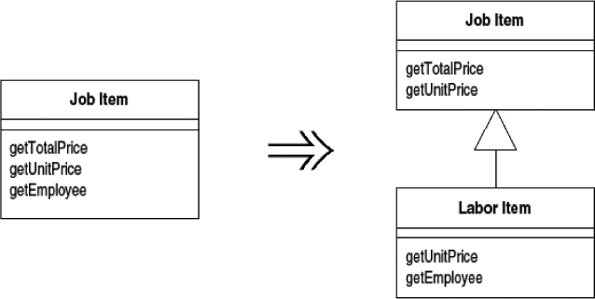
Extract Subclass

Slide 3
When to Extract Subclass
Class JobItem {
  …
  private int unitPrice;
  private Employee employee;
  private boolean laborItem;
  public JobItem(…){
  …
  }
  public void setEmployee(…,Employee e){
  employee = e;
  }
  public int getUnitPrice(){
  return unitPrice;
  }
  public employee getEmployee(){
  return employee;
  }
  public boolean isLaborItem(){
  return laborItem;
  }
  public int getTotalPrice(){
  if(laborItem){
  totalPrice = ….;
  }
  else{
  totalPrice = ….;
  }
  return totalPrice;
  }
}
Class has methods/ variables which are used only in certain cases
Hints:
  Boolean flags
  Some fields are left null/0
  Frequent if statements in get methods
Does your class describe more than one thing?

Slide 4
Class JobItem {
  …
  private int unitPrice;
  private Employee employee;
  private boolean laborItem;
  public JobItem(…){
  …
  }
  public int getUnitPrice(){
  return unitPrice;
  }
  public employee getEmployee(){
  return employee;
  }
  public boolean isLaborItem(){
  return laborItem;
  }
  public int getTotalPrice(){
  if(laborItem){
  totalPrice = ….;
  }
  else{
  totalPrice = ….;
  }
  return totalPrice;
  }
}
Extract the rare case into it’s own class and extend it to the original class:
(methods, private variables, etc.)
Class LaborItem extends JobItem {
  private Employee employee;
  public LaborItem(…, Employee e){
  super(…);
  employee = e;
  }
  public boolean isLaborItem(){
  return true;
  }
  Public int getTotalPrice(){
  totalPrice = …;
  return totalPrice;
  }

Slide 5
Class JobItem {
  …
  private int unitPrice;
  private Employee employee;
  private boolean laborItem;
  public JobItem(…){
  …
  }
  public void setEmployee(…,Employee e){
  employee = e;
  }
  public int getUnitPrice(){
  return unitPrice;
  }
  public employee getEmployee(){
  return employee;
  }
  public boolean isLaborItem(){
  return laborItem;
  }
  public int getTotalPrice(){
  if(laborItem){
  totalPrice = ….;
  }
  else{
  totalPrice = ….;
  }
  return totalPrice;
  }
}
Remove:
Any extracted lines
Unnecessary conditional statements
Class JobItem {
  …
  private int unitPrice;
  public JobItem(…){
  …
  }
  public int getUnitPrice(){
  return unitPrice;
  }
  public boolean isLaborItem(){
  return false;
  }
  public int getTotalPrice(){
  totalPrice = ….;
  return totalPrice;
  }
}

Slide 6
Result:
Class JobItem {
  …
  private int unitPrice;
  public JobItem(…){
  …
  }
  public int getUnitPrice(){
  return unitPrice;
  }
  public boolean isLaborItem(){
  return false;
  }
  public int getTotalPrice(){
  totalPrice = ….;
  return totalPrice;
  }
}
Class LaborItem extends JobItem {
  private Employee employee;
  public LaborItem(…, Employee e){
  super(…);
  employee = e;
  }
  public boolean isLaborItem(){
  return true;
  }
  Public int getTotalPrice(){
  totalPrice = …;
  return totalPrice;
  }

Slide 7
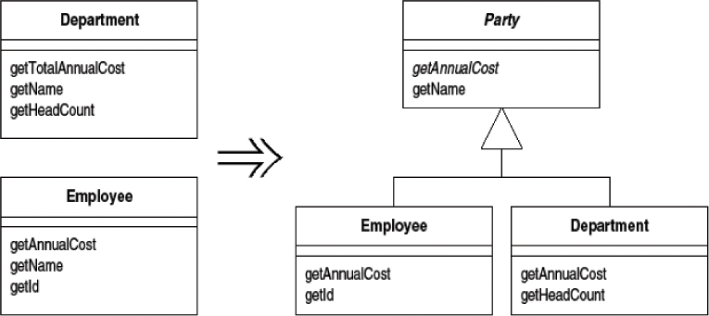
Extract Superclass

Slide 8
When to Extract Superclass
Class Department{
  …
  private string Name;
  private int Cost;
  private List Personel;
  public Department(…){
  …
  }
  public int getTotalAnnualCost(){
  totalCost = …;
  return totalCost;
  }
  public string getName(){
  return Name;
  }
  public int getHeadCount(){
  totalPrice = ….;
  return totalPrice;
  }
}
Class Employee {
  private string Name;
  private string ID;
  private int salary;
  public Employee(…){
  …
  }
  public int getAnnualCost(){
  return salary*12;
  }
  public string getID(){
  return ID;
  }
  public string getName(){
  return Name;
  }
}
Classes have common fields/methods
Hints:
  Similar named variables
  Used in similar situations

Slide 9
Create new class out of repeated code:
(Similar methods with different implementations make abstract)
Class Department{
  …
  private string Name;
  private int Cost;
  private List Personel;
  public Department(…){
  …
  }
  public int getTotalAnnualCost(){
  totalCost = …;
  return totalCost;
  }
  public string getName(){
  return Name;
  }
  public int getHeadCount(){
  totalPrice = ….;
  return totalPrice;
  }
}
Class Employee {
  private string Name;
  private string ID;
  private int salary;
  public Employee(…){
  …
  }
  public int getAnnualCost(){
  return salary*12;
  }
  public string getID(){
  return ID;
  }
  public string getName(){
  return Name;
  }
}
Class Party{
  …
  private string Name;
  public Party(…){
  …
  }
  public abstract int getAnnualCost();
  public string getName(){
  return Name;
  }
}

Slide 10
Remove the extracted lines and extend the subclasses:
Class Department{
  …
  private string Name;
  private int Cost;
  private List Personel;
  public Department(…){
  …
  }
  public int getTotalAnnualCost(){
  totalCost = …;
  return totalCost;
  }
  public string getName(){
  return Name;
  }
  public int getHeadCount(){
  totalPrice = ….;
  return totalPrice;
  }
}
Class Party{
  …
  private string Name;
  public Party(…){
  …
  }
  public abstract int getAnnualCost();
  public string getName(){
  return Name;
  }
}
Class Department extends Party{
  …
  private int Cost;
  private List Personel;
  public Department(…){
  super(…);
  …
  }
  public int getAnnualCost(){
  totalCost = …;
  return totalCost;
  }
  public int getHeadCount(){
  totalPrice = ….;
  return totalPrice;
  }
}

Slide 11
Remove the extracted lines and extend the subclasses:
Class Employee {
  private string Name;
  private string ID;
  private int salary;
  public Employee(…){
  …
  }
  public int getAnnualCost(){
  return salary*12;
  }
  public string getID(){
  return ID;
  }
  public string getName(){
  return Name;
  }
}
Class Party{
  …
  private string Name;
  public Party(…){
  …
  }
  public abstract int getAnnualCost();
  public string getName(){
  return Name;
  }
}
Class Employee extends Party{
  private string ID;
  private int salary;
  public Employee(…){
  super(…);
  …
  }
  public int getAnnualCost(){
  return salary*12;
  }
  public string getID(){
  return ID;
  }
}

Slide 12
Result:
Class Department extends Party{
  …
  private int Cost;
  private List Personel;
  public Department(…){
  super(…);
  …
  }
  public int getAnnualCost(){
  totalCost = …;
  return totalCost;
  }
  public int getHeadCount(){
  totalPrice = ….;
  return totalPrice;
  }
}
Class Party{
  …
  private string Name;
  public Party(…){
  …
  }
  public abstract int getAnnualCost();
  public string getName(){
  return Name;
  }
}
Class Employee extends Party{
  private string ID;
  private int salary;
  public Employee(…){
  super(…);
  …
  }
  public int getAnnualCost(){
  return salary*12;
  }
  public string getID(){
  return ID;
  }
}

Slide 13
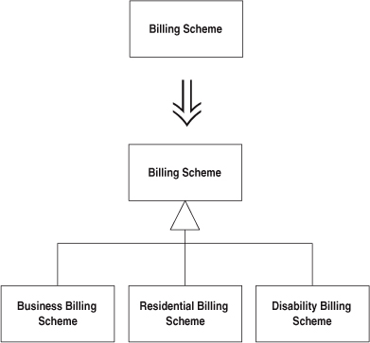
Extract Hierarchy

Slide 14
When to use it:
Class Billingscheme{
Something thing;
…
public Something getSomething(){
if(…){
thing = …;
}
else if(…){
thing = …;
}
else if(…){
thing = …;
}
…
return thing;
}
public int billBuisness(…){
return …;
}
public int billResidence(…){
return …;
}
public int billDisabled(…){
return …;
}
}
      A Class is trying to do too much work
      Hints:
          Lots of if else statements
          Helper methods for a variety of scenarios
          Multiple problems from both the Extract Subclass and Extract Superclass…
      What one thing does your class describe?

Slide 15
How to Extract Hierarchy
Identify each variation
Create a subclass around that variation
May use a variety of refactoring:
  Extract Subclass
  Extract Superclass
  Extract Method
  Pull Down
  Push Down
  Etc.
Class BillingScheme{
…
public abstract Something getSomething();
}
Class BuisnessBillingScheme extends Billing Scheme {
…
}
Class ResidentBillingScheme extends Billing Scheme {
…
}
Class DisabilityBillingScheme extends Billing Scheme {
…
}

