Slide 1
Refactoring Strategies
Josh Schenk

Slide 2
Types
Form Template Method
Decompose Conditional
Push Down Field

Slide 3
Form Template Method
Situation: When two subclasses contain similar functionality
Solution: Merge the functionality into the superclass

Slide 4
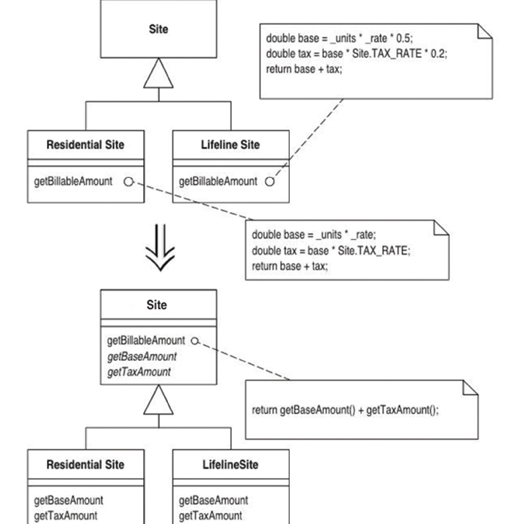

Slide 5
Decompose Conditional
Situation: Conditional clauses are bulky and difficult to interpret
Solution: Decompose the functionality into multiple components

Slide 6
if (date.before (SUMMER_START) || date.after(SUMMER_END))
charge = quantity * _winterRate + _winterServiceCharge;
else charge = quantity * _summerRate;
if (notSummer(date))
charge = winterCharge(quantity);
else charge = summerCharge (quantity);

Slide 7
Push Down Field
Situation: Field in superclass is only used by some subclasses
Solution: Move field to those subclasses

Slide 8
