Slide 1
Refactoring
Ian VanBuren

Slide 2
Overview
Change Reference to Value
Replace Exception with Test
Remove Parameter

Slide 3
Change Reference to Value
Replace a mutable reference with an immutable value
Add a hashcode and equals function

Slide 4
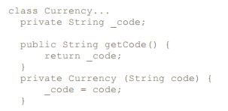
Code Example

Slide 5
Replace Exception with Test
While exceptions may help with debugging, they should not be used in case of tests
Use conditional tests instead of exceptions unless you have a truly “exceptional” issue

Slide 6
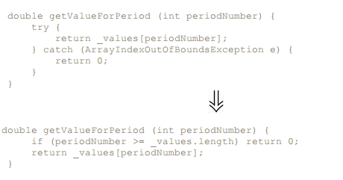
Code Example

Slide 7
Remove Parameter
Parameters that are no longer used should be removed
Can lead to problems with polymorphic methods especially

Slide 8
Example

Slide 9
Questions?

