Slide 1
Rename Method
Introduce Assertion
Consolidate Duplicate Conditional Fragments
//code refactoring
By Cyndy Marie Ejanda

Slide 2
Rename Method
Problem
The name of a method does not explain what the method does.
Solution
Rename the method.
(a)
(b)
//code refactoring
Refactoring: Improving the Design of Existing Code
Notes:
The name of a method does not reveal its purpose.
Change the name of the method.

Slide 3
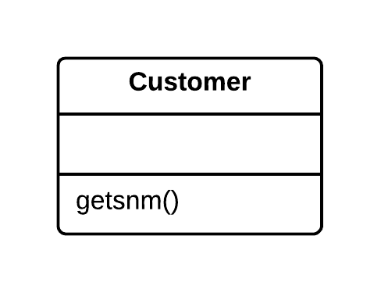
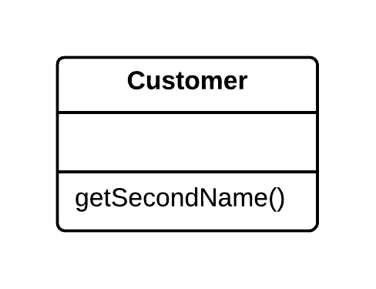
Rename Method
When
Poorly written method names
Method functionality grew
Why
Code Readability
How (one way to do it)
Create a new method with a new name
Copy the code of the old method to it
Delete all the code in the old method
Insert a call for the new method
//code refactoring
https://sourcemaking.com/refactoring/rename-method
Notes:
When:
Poorly written method names
Well named method but its functionality grew or changed; the method name stopped being a good descriptor
Why:
Code readability – method name should reflect the method’s functionality
How:
Couple ways of doing it
Create a new method with a new name. Copy the code of the old method to it. Delete all the code in the old method and, instead of it, insert a call for the new method.
Find all references to the old method and replace them with references to the new one.
Delete the old method. If the old method is part of a public interface, do not perform this step. Instead, mark the old method as deprecated.

Slide 4
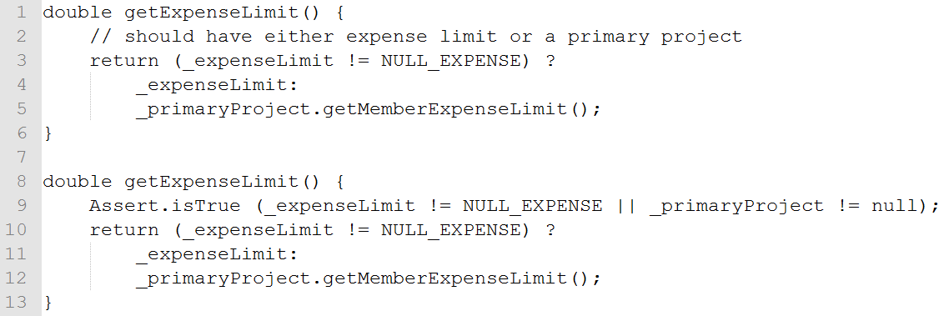
Introduce Assertion
Problem
For a portion of code to work correctly, certain conditions or values must be true.
Solution
Replace these assumptions with specific assertion checks.
//code refactoring
Refactoring: Improving the Design of Existing Code

Slide 5
Introduce Assertion
When
Certain conditions or values must be true.
Why
Avoid fatal consequences and data corruption
Drawbacks
Exception vs Assertion
//code refactoring
https://sourcemaking.com/refactoring/introduce-assertion
Notes:
When:
Say that a portion of code assumes something about, for example, the current condition of an object or value of a parameter or local variable. Usually this assumption will always hold true except in the event of an error.
Why:
If an assumption is not true and the code therefore gives the wrong result, it is better to stop execution before this causes fatal consequences and data corruption.
This also means that you neglected to write a necessary test when devising ways to perform testing of the program.
Drawbacks:
Sometimes an exception is more appropriate than a simple assertion. You can select the necessary class of the exception and let the remaining code handle it correctly.
When is an exception better than a simple assertion? If the exception can be caused by actions of the user or system and you can handle the exception.
On the other hand, ordinary unnamed and unhandled exceptions are basically equivalent to simple assertions – you do not handle them and they are caused exclusively as the result of a program bug that never should have occurred.

Slide 6
Consolidate Duplicate Conditional Fragments
Problem
Identical code can be found in all branches of a conditional.
Solution
Move the code outside of the conditional.
//code refactoring
Refactoring: Improving the Design of Existing Code
Notes:
Sometimes you find the same code executed in all legs of a conditional. In that case you should move the code to outside the conditional. This makes clearer what varies and what stays the same.

Slide 7
Consolidate Duplicate Conditional Fragments
When
you find the same code executed in all legs of a conditional
Why
Code deduplication
How
Identify code that is executed the same way regardless of the condition.
If the common code is at the beginning, move it to before the conditional.
If the common code is at the end, move it to after the conditional.
//code refactoring
https://sourcemaking.com/refactoring/consolidate-duplicate-conditional-fragments
Notes:
When:
Duplicate code is found inside all branches of a conditional, often as the result of evolution of the code within the conditional branches.
Why:
Code deduplication – avoid redundancy; make things more clear
Drawbacks:
If the duplicated code is at the beginning of the conditional branches, move the code to a place before the conditional.
If the code is executed at the end of the branches, place it after the conditional.
If the duplicate code is randomly situated inside the branches, first try to move the code to the beginning or end of the branch, depending on whether it changes the result of the subsequent code.
If appropriate and the duplicate code is longer than one line, try using Extract Method.

Slide 8
Rename Method
Code Readability
Introduce Assertion
Avoid fatal consequences and data corruption
Consolidate Duplicate Conditional Fragments
Code deduplication
//code refactoring

