Slide 1
Refactoring Types
Blake Duncan

Slide 2
Add Parameter
Add Parameter is a very common refactoring, one that you almost certainly have already done. The motivation is simple. You have to change a method, and the change requires information that wasn’t passed in before, so you add a parameter.

Slide 3
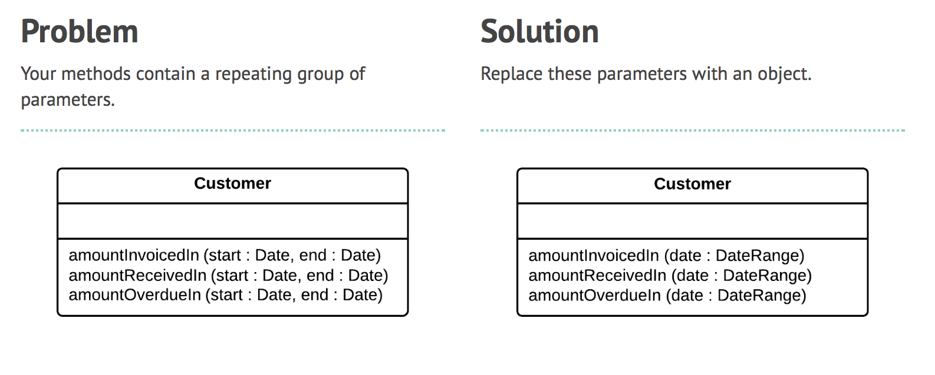
Add Parameter

Slide 4
Add Parameters
Benefit:
  Allows you to pass more information from the calling method
  New parameter can be used to simplify implementation or add functionality
Con:
  Often you have other alternatives to adding a parameter. If available, these alternatives are better because they don’t lead to increasing the length of parameter lists. Long parameter lists smell bad because they are hard to remember and often involve data clumps.

Slide 5
Collapse Hierarchy
If you have been working for a while with a class hierarchy, it can easily become too tangled for its own good. Refactoring the hierarchy often involves pushing methods and fields up and down the hierarchy. After you’ve done this you can well find you have a subclass that isn’t adding any value, so you need to merge the classes together.

Slide 6
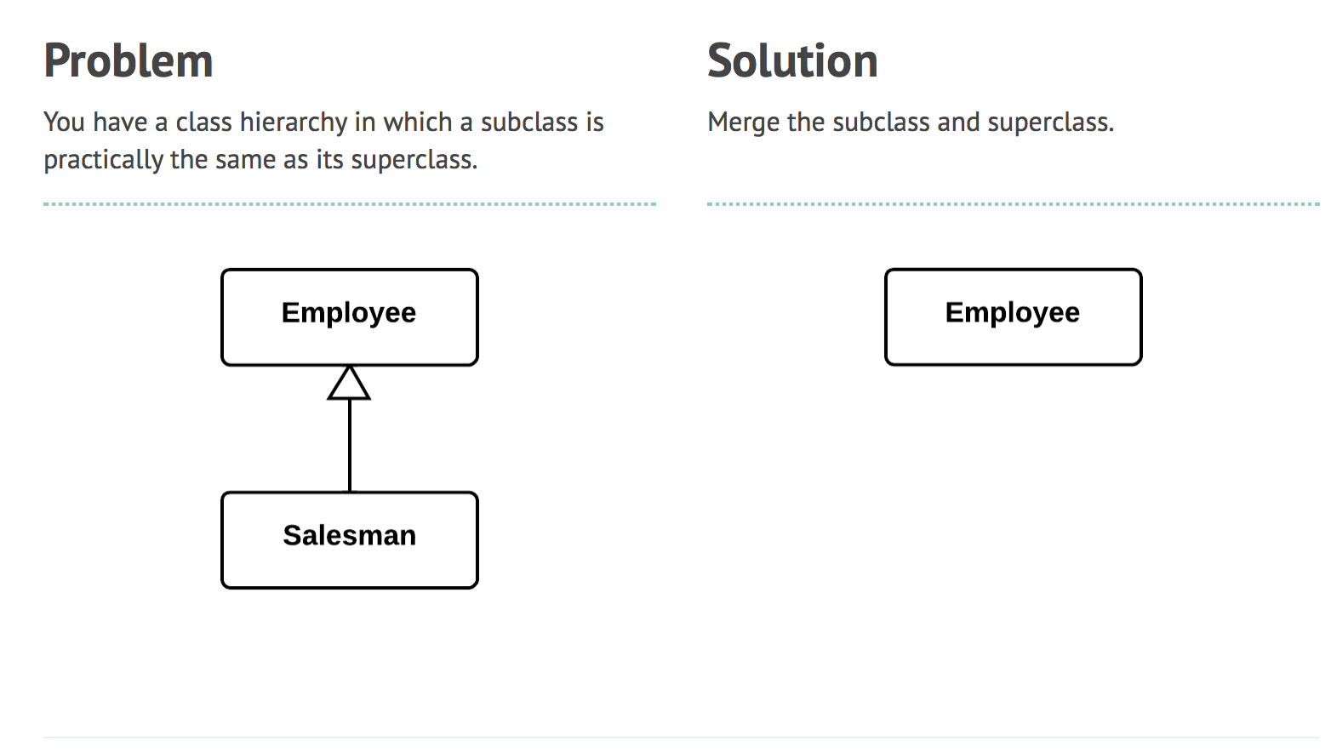
Collapse Hierarchy

Slide 7
Collapse Hierarchy
Benefit
  The program complexity is reduced because there are now fewer classes.
  Navigating through your code is easier when methods are defined in one class early. You do not need to comb through the entire hierarchy to find a particular method.

Slide 8
Consolidate Conditional Expression
Sometimes you see a series of conditional checks in which each check is different yet the resulting action is the same. When you see this, you should use ands and ors to consolidate them into a single conditional check with a single result.

Slide 9
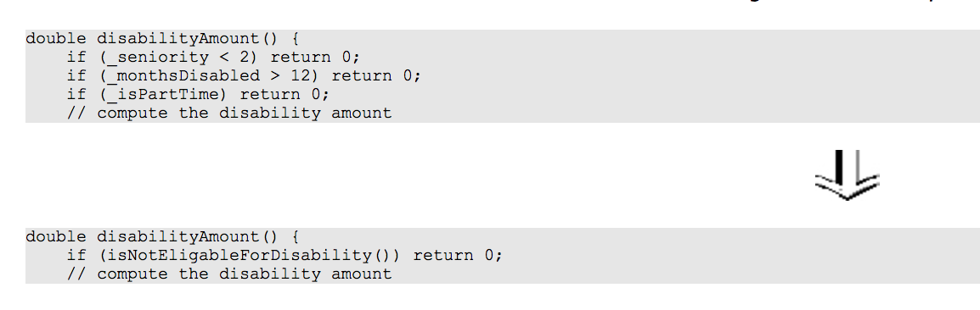
Consolidate Conditional Expression Example

Slide 10
Consolidate Conditional Expression
Benefit
  By consolidating all operators, you can now isolate this complex expression in a new method with a name that explains the conditional's purpose.
  Eliminates duplicate control flow code. Combining multiple conditionals that have the same "destination" helps to show that you are doing only one complicated check leading to one action.

