Slide 1
Observer Design Pattern
Darius Vallejo

Slide 2
Problem
Suppose multiple objects depend on another object
Suppose multiple objects should be in sync
Ex:
Excel sheet
Video game trophy system
Airport baggage claim information system
Web blog and subscribers
Notes:
Consider designing a system in which multiple objects depend on the state of one object and all these multiple objects should be in sync with the state of this one object.
Such a system may be found in an excel sheet program, where data is shown to the user in different views, a video game trophy system, where players are rewarded for in-game accomplishments, an airport baggage claim information system, where users can lookup baggage information, or in web blog and subscriber interactions, where subscribers follow a blogger’s activities
To design such a system, an observer design pattern may be used
Generally data is is shown in grid cells and as required different graphs, charts can be created for same data. Underlying data is same and when that data (subject) state changes all the different view are updated.
http://javapapers.com/design-patterns/observer-design-pattern/
Say we’re adding an achievements system to our game. It will feature dozens of different badges players can earn for completing specific milestones like “Kill 100 Monkey Demons”, “Fall off a Bridge”, or “Complete a Level Wielding Only a Dead Weasel”.
http://gameprogrammingpatterns.com/observer.html
The following example uses the observer design pattern to implement an airport baggage claim information system.
https://msdn.microsoft.com/en-us/library/ee850490(v=vs.110).aspx
Blog and subscriber
http://javapapers.com/design-patterns/observer-design-pattern/

Slide 3
Solution
Observer (Behavioral) Design Pattern
Define one-to-many dependency between objects
When one object changes state, notify dependents
Subjects: Objects that change
Observers: Objects that receive updates
Notes:
The observer design pattern defines a one-to-many dependency between objects so that when one object changes state, all its dependents are notified and updated automatically.
It identifies common communication patterns between objects and realizes these patterns
Objects that change are called subjects, and objects that receive updates are called observers
behavioral design patterns are design patterns that identify common communication patterns between objects and realize these patterns. By doing so, these patterns increase flexibility in carrying out this communication.
wikipedia.com
About how classes or objects interact and distribute responsibility
files.com
Define a one-to-many dependency between objects so that when one object changes state, all its dependents are notified and updated automatically.
https://sourcemaking.com/design_patterns/observer
Objects that change are called “Subjects”
Objects that receive updates are called “Observers”

Slide 4
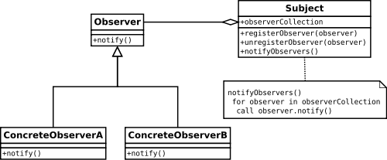
Observer Design Pattern
Subject (provider / observable), zero or more observers
Observers register with provider
Provider notifies observers
Used in event handling systems
Key part in MVC
Pervasive (java.util.Observer, etc)
Notes:
The pattern defines a subject and allows it to be watched by zero or more observers, forming a publish-subscribe relationship. Observers register with the provider, and whenever a predefined condition, event, or state change occurs, the provider automatically notifies all observers by calling one of their methods. In this method call, the provider can also provide current state information to observers.
It is mainly used to implement distributed event handling systems. The observer pattern is also a key part in the model-view-controller architectural pattern. The pattern is implemented in numerous programming libraries and systems, including almost all GUI toolkits.
To the right, a UML Class Diagram is provided illustrating the design pattern.
The pattern defines a provider (also known as a subject or an observable) and zero, one, or more observers. Observers register with the provider, and whenever a predefined condition, event, or state change occurs, the provider automatically notifies all observers by calling one of their methods. In this method call, the provider can also provide current state information to observers.
https://msdn.microsoft.com/en-us/library/ee850490(v=vs.110).aspx
Simply, the Observer pattern allows one object (the observer) to watch another (the subject). The Observer pattern allows the subject and observer to form a publish-subscribe relationship. Through the Observer pattern, observers can register to receive events from the subject. When the subject needs to inform its observers of an event, it simply sends the event to each observer.
http://www.javaworld.com/article/2077444/learn-java/speaking-on-the-observer-pattern.html
It is mainly used to implement distributed event handling systems. The Observer pattern is also a key part in the familiar model–view–controller (MVC) architectural pattern.^{[1]} The observer pattern is implemented in numerous programming libraries and systems, including almost all GUI toolkits.
https://msdn.microsoft.com/en-us/library/ff649643.aspx
Observer is so pervasive that Java put it in its core library (java.util.Observer) and C# baked it right into the language (the eventkeyword).
http://gameprogrammingpatterns.com/observer.html

Slide 5
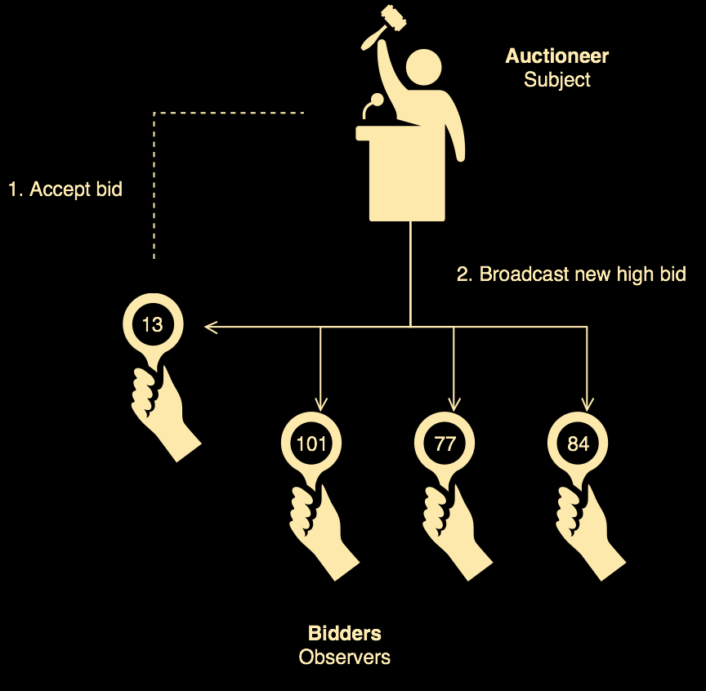
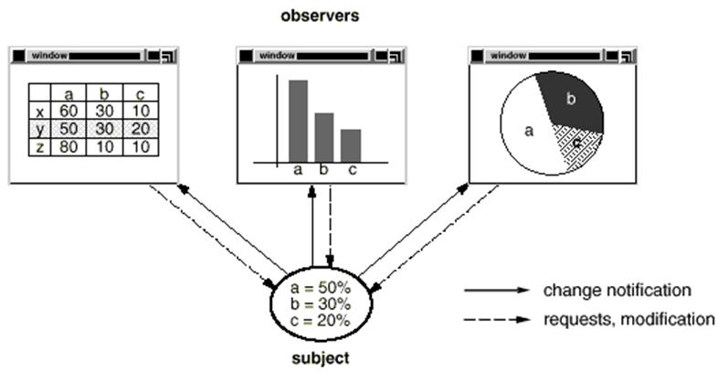
Observer Examples
Notes:
For a real life example, some auctions demonstrate the observer design pattern. Each bidder possesses a numbered paddle that is used to indicate a bid. The auctioneer starts the bidding, and "observes" when a paddle is raised to accept the bid. The acceptance of the bid changes the bid price which is broadcast to all of the bidders in the form of a new bid.
For another example, to the right is an image of the relationship between excel graphs and their data using the design pattern
https://sourcemaking.com/design_patterns/observer
The protocol described above specifies a "pull" interaction model. Instead of the Subject "pushing" what has changed to all Observers, each Observer is responsible for "pulling" its particular "window of interest" from the Subject. The "push" model compromises reuse, while the "pull" model is less efficient.

Slide 6
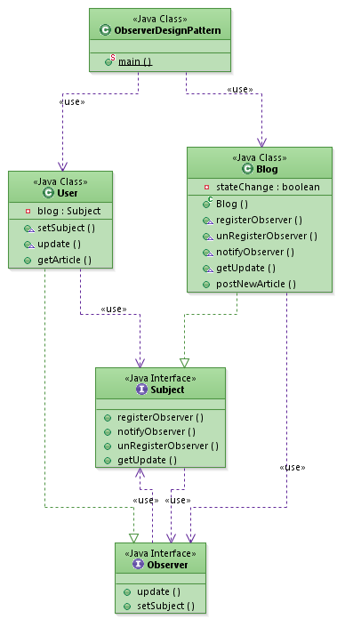
Notes:
Here’s a class diagram for the blog and subscriber example again for a sample implementation.
Assume that there is a blog and users register to that blog for updates.
When a new article is posted in the blog, it will send an update to the registered users saying a new article is posted.
Then the user will access the blog and read the new article posted.
In this example, blog is the subject and user is the observer.

Slide 7
Implementation
Requires:
Provider / Subject
Observer
Observer tracking (for Provider)
Observer disposal
Data object
How does the subject send changed data?
Pull: Observer invokes method requesting data (SubjectName.getdata();)
Push: Subject passes data to observer (Object[i].update(SubjectName.data))
Notes:
Implementing the observer design pattern requires:
A provider or subject, which is the object that sends notifications to observers.
An observer, which is an object that receives notifications from a provider.
A mechanism that allows the provider to keep track of observers. Typically, the provider uses a container object, such as a List object.
An implementation that enables the provider to remove observers when notification is complete
And an object that contains the data that the provider sends to its observers.
One thing that must be decided between implementations is whether to push or pull the changed data
In a pull model, the observer invokes the method, requesting data from the subject
In the push model, the subject will pass the data to the observer as an argument during an update call
https://msdn.microsoft.com/en-us/library/ee850490(v=vs.110).aspx
How does the subject send the changed data to object?
Pull model: observer invoke method requesting data (SubjectName.getdata();)
Push model: Subject passes data to observer as argument at update() (Object[i].update(SubjectName.data))

Slide 8
Key Points
Subject provides interface for observers to (un) register
Subject knows who its subscribers are
Multiple observers can subscribe for notifications
Subject publishes the notifications
Optional: Subject passes state information
Optional: Observers call subject and get data
Notes:
The key points of the design pattern are that it has a subject that provides an interface for observers to register and unregister themselves with the subject,
it has subjects that knows who its subscribers are,
it allows multiple observers to subscribe for notifications,
and it has subjects that publish the notifications.
The last two points, passing of state information and subject data call, are not strictly followed in the observer design pattern implementation. Along with the notification, the state information or data are typically passed in some implementation so that the observer doesn’t need to query back to know the status
Subject just sends the notification saying the state has changed. It does not pass any state information.
Once the notification is received from subject, observers call the subject and get data that is changed.
The above last two points are not strictly followed in observer design pattern implementation. Along with the notification, state is also passed in some implementation so that the observer need not query back to know the status. It is better not to do this way.
http://javapapers.com/design-patterns/observer-design-pattern/
Differentiate between the core (or independent) functionality and the optional (or dependent) functionality.
Model the independent functionality with a "subject" abstraction.
Model the dependent functionality with an "observer" hierarchy.
The Subject is coupled only to the Observer base class.
The client configures the number and type of Observers.
Observers register themselves with the Subject.
The Subject broadcasts events to all registered Observers.
The Subject may "push" information at the Observers, or, the Observers may "pull" the information they need from the Subject.
https://sourcemaking.com/design_patterns/observer

Slide 9
Pros vs. Cons
Pros
Requires deeper thinking about relationship between components
Helps pinpoint dependencies
Good at decoupling objects
Reuse subjects without reusing observers, vice versa
Cons
Checking application integrity can become difficult
Switching subscriber from one publisher to another is costly
Can cause memory leaks
Notes:
Requires deeper-level thinking of the relationship between the various components of an application
Helps pinpoint dependencies
Good at decoupling objects which often promotes smaller, reusable components
Can reuse subjects without reusing their observers and vice versa
Checking the integrity of your application can become difficult
Switching a subscriber from one publisher to another can be costly
The observer pattern can cause memory leaks, known as the lapsed listener problem, because in basic implementation it requires both explicit registration and explicit deregistration.The leak happens when a listener forgets to unsubscribe from the publisher when it does not need to listen anymore. Consequently, the publisher still holds a reference to the observer which prevents it from being garbage collected — including all other objects it is referring to — for as long as the publisher is alive, which could be until the end of the application.
https://carldanley.com/js-observer-pattern/
This causes not only a memory leak, but also a performance degradation with an "uninterested" observer receiving and acting on unwanted events. This can be prevented by the subject holding weak references to the observers, allowing them to be garbage collected as normal without needing to be unregistered.
Wikipedia.com
Benefits:

Slide 10
Sources
http://javapapers.com/design-patterns/observer-design-pattern/
http://gameprogrammingpatterns.com/observer.html
https://msdn.microsoft.com/en-us/library/ee850490(v=vs.110).aspx
https://sourcemaking.com/design_patterns/observer
http://www.javaworld.com/article/2077444/learn-java/speaking-on-the-observer-pattern.html
https://msdn.microsoft.com/en-us/library/ff649643.aspx
https://carldanley.com/js-observer-pattern/

