Slide 1
Memento Design Pattern
Lee Lisle

Slide 2
Overview
Why would we use Memento?
Examples of Memento
How to implement Memento

Slide 3
Why Memento?
Undo
Checkpointing
Saving a program’s state

Slide 4
Examples
Rectangles
See Design Patterns book, Memento section
Not a direct example
Re-use of a method doesn’t guarantee the same result

Slide 5
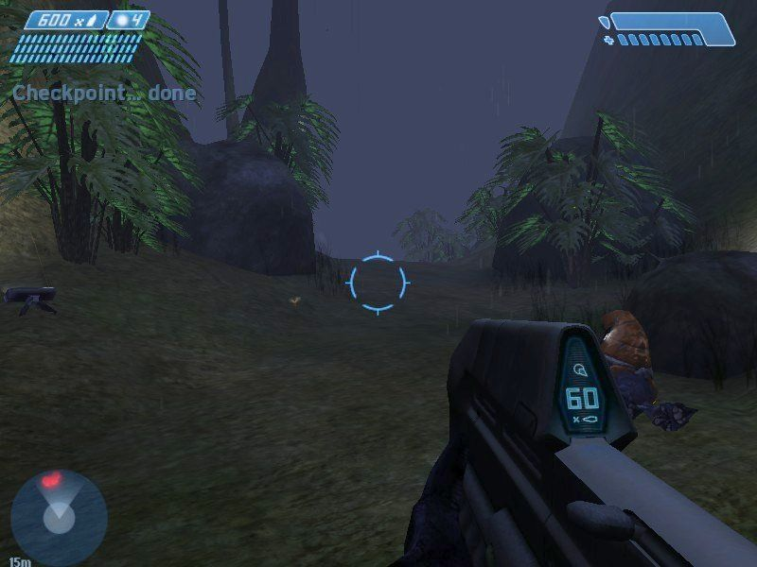
Mementos in Games

Slide 6
How to use Memento
Three “actors” in a Memento
The Memento Object
The originator
The caretaker
Ideally the Memento is not stored by the Originator
Enables “saving”
The Caretaker keeps the object but doesn’t read it
Wide versus Narrow Interfaces (friend descriptor in C++)

Slide 7
Java Example – Wikibook Computer Science Design Patterns
https://en.wikibooks.org/wiki/Computer_Science_Design_Patterns/Memento

Slide 8
Memento Design Pattern
Why?
Memory
What?
Timing for solvers
Games
How?
Caretaker, Originator, Memento
Works Cited
Gamma, Erich. Design Patterns: Elements of Reusable Object Oriented Software. Addison-Wesley Professional. 1995.
Memento. https://en.wikibooks.org/wiki/Computer_Science_Design_Patterns/Memento. January 2014. October 2015.

