Slide 1
Design Pattern:
Facade
By Christopher Aska Toda

Slide 2
What is Façade?
Hides complexities of the system, and provides a simpler interface for ease of use and easier understanding
Defines a higher-level interface that makes the subsystem easier to use
Wrapper class containing set of required members for complicated subsystem with simpler interface
Decouples code that uses the system, easy modification
Notes:
Complex system: large number of interdependent classes

Slide 3
Problem
Operations made in sequence, where same action is required in multiple places within application
Modification will be a pain by changing code in different places

Slide 4
Solution
Create a lead controller that handles all of the repeating codes.
Call the lead controller, based on the parameters provided, to perform actions
Just change the lead controller, to make changes of the code in the process

Slide 5
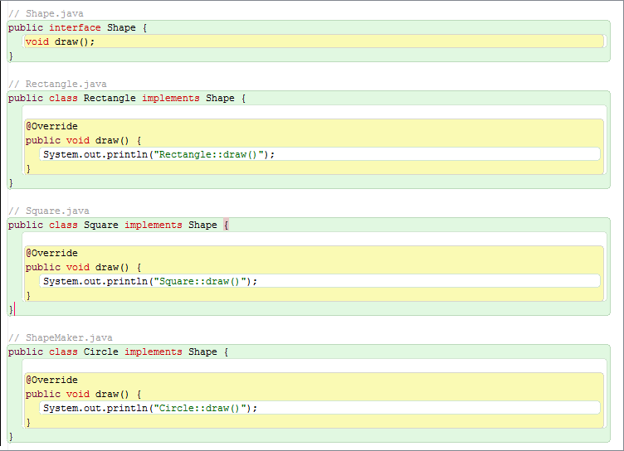
Example

Slide 6
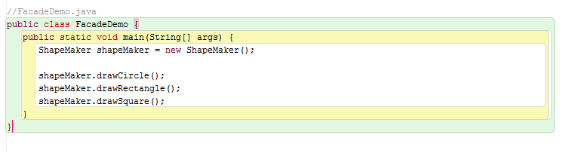
Example (cont’d)

Slide 7
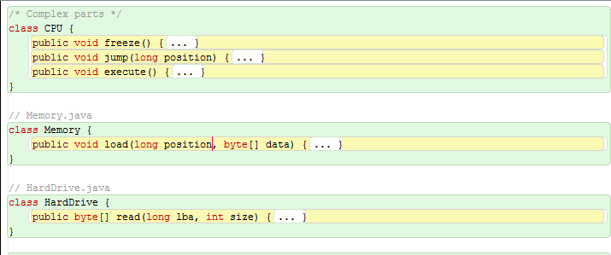
Example 2

Slide 8
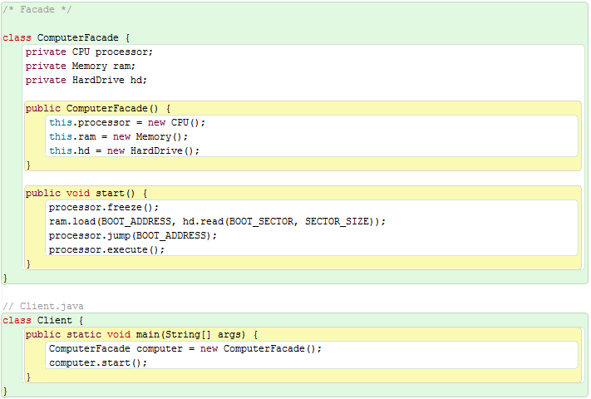
Example 2 (cont’d)

Slide 9
Keypoint(s)
Façade: Makes complex interface easier to use, using a Façade class.
Complex system: Large number of interacting components, and code that is hard to understand
Interface: Shared boundary across which two separate components of a computer system exchange information
Decouple: Relationship in which one module interacts has less interdependency with another module

