Slide 1
Decorator Design Pattern
Phillip Shin

Slide 2
Overview
Problem
Solution
Example
Key points

Slide 3
Problem
Want to add responsibilities to individual objects, not entire class
Inheritance is inflexible
Would have to create class for every different combination of functionality

Slide 4
Solution
Wrap the component in another object that adds functionality on a per need basis
Wrapper called a Decorator

Slide 5
Participants
Component (window)
Defines interface for “decoratable” objects
Concrete Component (simple window)
Object which can be decorated
Decorator (window decorator)
Maintains reference to component and conforms interface to component
Concrete Decorators (horizontal and vertical scroll bar decorators)
Adds responsibilities to component

Slide 6
Example

Slide 7
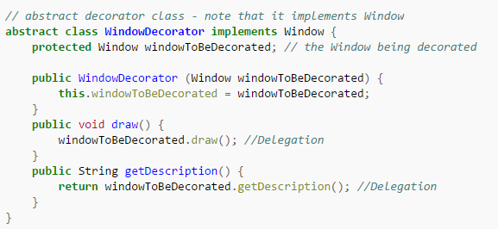

Slide 9
Example
The output of this program is "simple window, including vertical scrollbars, including horizontal scrollbars"

Slide 10
Key Points
Alternative to sub classing, which adds behavior at compile time, changing all subclasses
Allows dynamic decoration of different instances of an object at run time
Used when there are several independent ways of extending functionality

