Slide 1
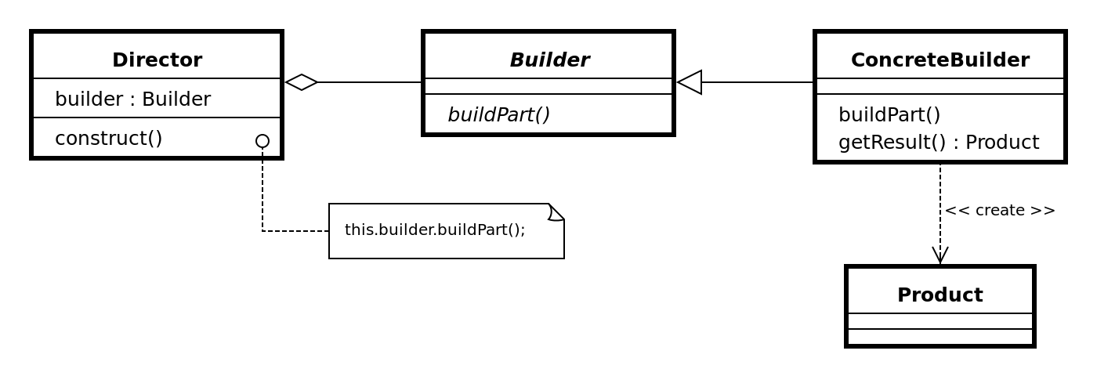
Builder Pattern

Slide 2
What’s Builder: TO find a solution to the telescoping constructor
Problem: Too many parameters
Solution: To get an abstract object, a builder, that receives each initialization parameter step by step and then returns the resulting constructed object at once

Slide 3
Example
public class User {
private final String firstName; //required
private final String lastName; //required
private final int age; //optional
private final String phone; //optional
private final String address; //optional
}

Slide 4
Option One
public User(String firstName, String lastName) {
this(firstName, lastName, 0);
}
public User(String firstName, String lastName, int age) {
this(firstName, lastName, age, '');
}
public User(String firstName, String lastName, int age, String phone) {
this(firstName, lastName, age, phone, '');
}
public User(String firstName, String lastName, int age, String phone, String address) {
this.firstName = firstName;
this.lastName = lastName;
this.age = age;
this.phone = phone;
this.address = address;
}

Slide 5
Option Two
public class User {
private String firstName; // required
private String lastName; // required
private int age; // optional
private String phone; // optional
private String address; //optional
public String getFirstName() {
return firstName;
}
public void setFirstName(String firstName) {
this.firstName = firstName;
}
public String getLastName() {
return lastName;
}
public void setLastName(String lastName) {
this.lastName = lastName;
}

Slide 6
public void setAge(int age) {
this.age = age;
}
public String getPhone() {
return phone;
}
public void setPhone(String phone) {
this.phone = phone;
}
public String getAddress() {
return address;
}
public void setAddress(String address) {
this.address = address;
}
}

Slide 7
Option Three
public class User {
private final String firstName; // required
private final String lastName; // required
private final int age; // optional
private final String phone; // optional
private final String address; // optional
private User(UserBuilder builder) {
this.firstName = builder.firstName;
this.lastName = builder.lastName;
this.age = builder.age;
this.phone = builder.phone;
this.address = builder.address;
}

Slide 8
public String getFirstName() {
return firstName;
}
public String getLastName() {
return lastName;
}
public int getAge() {
return age;
}

Slide 9
public String getPhone() {
return phone;
}
public String getAddress() {
return address;
}

Slide 10
public static class UserBuilder {
private final String firstName;
private final String lastName;
private int age;
private String phone;
private String address;
public UserBuilder(String firstName, String lastName) {
this.firstName = firstName;
this.lastName = lastName;
}

Slide 11
public UserBuilder age(int age) {
this.age = age;
return this;
}
public UserBuilder phone(String phone) {
this.phone = phone;
return this;
}
public UserBuilder address(String address) {
this.address = address;
return this;
}
public User build() {
return new User(this);
}

Slide 12
public User getUser() {
return new
User.UserBuilder('Jhon', 'Doe')
.age(30)
.phone('1234567')
.address('Fake address 1234')
.build();
}

