Slide 1
The basics of mathematical modeling

Slide 3
Flattening the “curve”

Slide 4
Some places chose lockdowns…

Slide 5
Some did not…

Slide 6
And the curve was still flattened

Slide 7
Just as well or better than in other places

Slide 8
The decision to avoid lockdown in Sweden was based on timely and, apparently, accurate mathematical modeling.
Source: BBC News

Slide 9
How to model, compute, understand (mitigate/prevent) the pandemic.

Slide 10
How to model it: basic steps.

Slide 11
How to model it: basic steps.

Slide 12
How to model it: basic steps.

Slide 13
How to model it: basic steps.

Slide 14
How to model it: basic steps.

Slide 15
How to model it: basic steps.

Slide 16
Choose level of coarse-graining: more details vs. fewer.

Slide 17
Choose level of coarse-graining: fewer.

Slide 18
Choose level of coarse-graining: minimal.
X(t)

Slide 19
The pros and cons: more details vs. less
Pros (very detailed picture): More information. Potentially more predictive power. Potentially more accurate.
Cons (detailed) More effort. May be too expansive to be useful. Many parameters needed to get going, as a result Not necessarily more accurate. May lose forest for the trees, harder to see “big picture” and infer key principles. Harder to check if correct.

Slide 20
Pros of a basic, minimal model.
Easy to set up Not too many parameters. Computationally tractable (usually). Gives you the big picture. Easy to do “sanity checks”.

Slide 21
A differential equation for the growth of the number of infected people.

Slide 22
One step further: a differential equation for the growth.

Slide 23
One step further: a differential equation for the growth.

Slide 24
One step further: a differential equation for the growth.

Slide 25
Check your first model

Slide 26
Check your first model

Slide 27
Check your first model

Slide 28
Check your first model

Slide 29
Check your first model

Slide 30
How to spot an exponential growth?

Slide 31
How to spot an exponential growth?

Slide 32
How to spot an exponential growth?
Use log-plot.

Slide 33
How good is your model?

Slide 34
How good is your model?

Slide 35
How good is your model?

Slide 36
The simplest solutions are most often the most effective and robust.

Slide 37
Improving the model: step 1

Slide 38
Improving the model: step 1

Slide 39
What R(x) might look like?

Slide 40
What R(x) might look like?
Simplest possible, not constant.

Slide 41
What R(x) might look like?
Simplest possible, not constant.

Slide 42
What R(x) might look like?

Slide 43
What R(x) might look like?

Slide 44
What R(x) might look like?

Slide 45
What R(x) might look like?

Slide 46
Improving the model: step 1

Slide 47
Improving the model: step 2

Slide 48
Explore the model in Mathematica
What else does the model need?
How does the initial number of infected people affect the course? (a) How many will get infected? (b) Per day? (c ) How high will the peak be? How soon? (d ) How long will it take to end?
How does R₀ (infectivity) affect the course? (a), (b)…

Slide 49
A more realistic model will account for spatial variation: X = X(location, time)
Venkatramanan S, Chen J, Fadikar A, Gupta S, Higdon D, et al. (2019) Optimizing spatial allocation of seasonal influenza vaccine under temporal constraints. PLOS Computational Biology 15(9): e1007111. https://doi.org/10.1371/journal.pcbi.1007111
https://journals.plos.org/ploscompbiol/article?id=10.1371/journal.pcbi.1007111

Slide 50
These kinds of models are used in policy decisions in VA

Slide 51
The Old version

Slide 52
Population dynamics

Slide 53
More over…
The flour beetle Tribolium pictured here has been studied in a laboratory in which the biologists experimentally adjusted the adult mortality rate (number dying per unit time). For some values of the mortality rate, an equilibrium population resulted. In other words, the total number of beetles did not change even though beetles were continually being born and dying. Yet, when the mortality rate was increased beyond some value, the population was found to undergo periodic oscillations in time. Under some conditions, the variation in population level became chaotic, that is, with no discernable regularity or repeating pattern. Why do we get such different-looking patters of population dynamics? What general mathematical model could produce both sets of patterns?
Example from R. Landau’s course, U. Oregon.

Slide 54
The basic model:
Population increase ΔP = birth – death.

Slide 55
The basic model:
Population increase ΔP = birth – death.
Birth = b*(current population) = bP. where b = birth rate.

Slide 56
Do we need to make the model more complex?
Check the outcomes. Do they make sense?
For convenience, convert difference equation to differential (we assume it is OK to do so).
So, ΔP -> dP, and, introducing the time interval dt (instead of unit time), we get dP = bPdt, or dP/dt = bP.
Solution? P(t)=?

Slide 59
Three qualitatively different solutions:

Slide 60
The basic model:
Population increase ΔP = birth – death.
Birth = b*(current population) = bP. where b = birth rate.
Death = ?

Slide 61
The basic model:
Population increase ΔP = birth – death.
Birth = b*(current population) = bP. where b = birth rate.
Death = ?
Death = d*(current population) ?

Slide 62
The basic model:
Population increase ΔP = birth – death.
Birth = b*(current population) = bP. where b = birth rate.
Death = ?
Death = d*(current population) ?
Death = -d*(current population) ² = dP²
ΔP = b*P(1 –(d/b)*P).

Slide 63
The discrete model:
ΔP = b*P(1 –(d/b)*P)
P(t+1) = P(t) + ΔP
Switch to dimensionless variable p:
P(t+1) = rp(t)*(1 – p).
A single parameter model: “r” controls the balance between birth and death. Meaning: r*(1-p) = effective growth rate, becomes zero when population reaches max.
What is needed to start a calculation?

Slide 64
Start with sanity checks. Basics behavior.
What if p << 1?

Slide 65
Start with sanity checks. Basics behavior.
What if p << 1?
What if p -> 1?

Slide 66
Start with sanity checks. Basics behavior.
What if p << 1?
What if p -> 1?
Steady state? No change, p(t+1) = p(t).

Slide 67
Start with sanity checks. Basics behavior.
What if p << 1?
What if p -> 1?
Steady state? No change, p(t+1) = p(t).
p=0, or 1 = r(1-p).

Slide 68
Some details

Slide 69
Explore the logistic equation using Mathematica

Slide 70
Origin of the oscillations and the chaos.

Slide 71
Graphical iterations of y = rx(1-x).
y=x
y = rx(1-x).

Slide 72
Graphical iterations of y = rx(1-x).

Slide 73
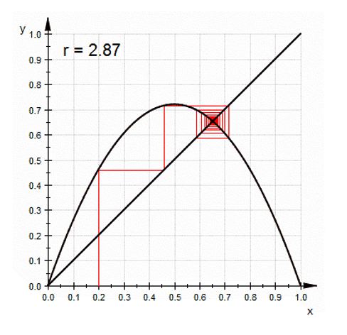
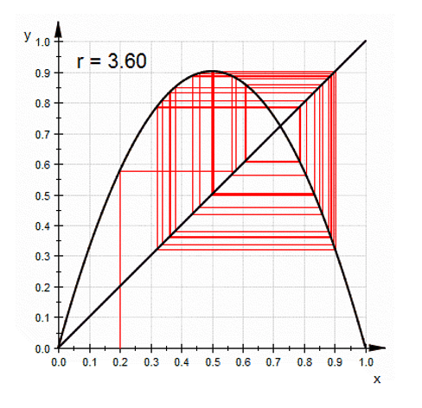
Graphical iterations of y = rx(1-x).

Slide 74
The bifurcation plot

Slide 75
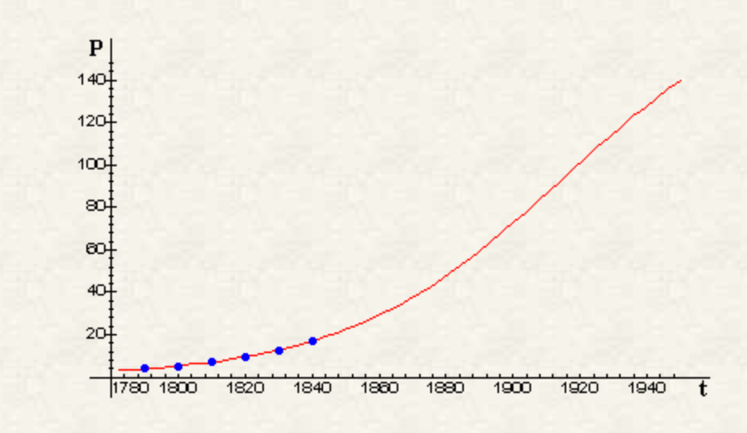
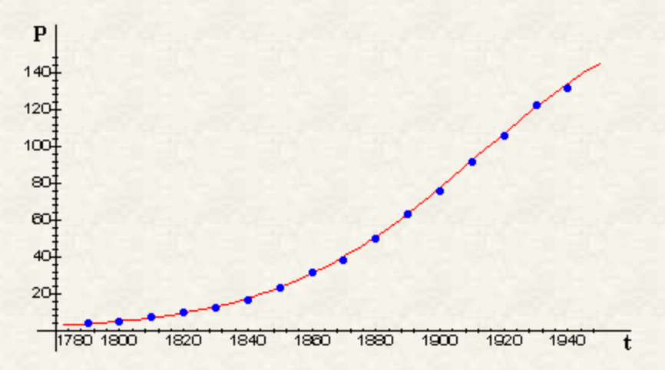
A good model must have generality
US census data.
Model prediction made in 1840
Actual data from 1940

Slide 76
The take home message:
You don’t need complexity for rich behavior; simple, basics models can still show very rich behavior.
Simpler models tend to be more general and robust, are more likely to hold water.
No need to overcomplicate things: simpler solutions are often right (think Geocentric vs. Heliocentric models).
Start from the very basics: do not introduce more complexity unless you absolutely can not describe the experiment without it.

