Slide 1
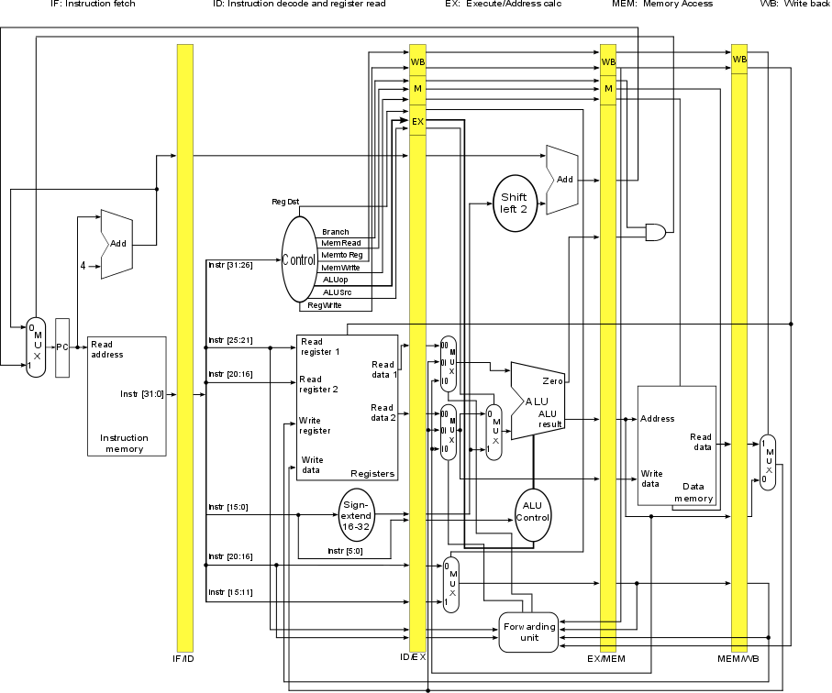
Unsimplified Datapath with Forwarding
Yes:
add
sub
and
or
slt
sw
No:
lw
beq
j
This design has:
logic for synchronizing control signals and instructions
forwarding logic
no hazard detection.

Slide 2
Load-Use Data Hazard
Consider the following sequence of instructions:
lw $t2, 20($t1) # writes a value
and $t4, $t2, $t5 # reads that value
This hazard cannot be resolved by simple forwarding… why not?
and lw
The value lw writes into $t2 is not available until lw completes the MEM stage, but and needs that value when it enters the EX stage, which is when lw enters the MEM stage.
QTP: why can this situation not occur if the writing instruction is R-type?

Slide 3
Handling a Load-Use Hazard
A load-use hazard requires delaying the execution of the using instruction until the result from the loading instruction can be made available to the using instruction.
lw $t2, 20($t1) # loads $t2
and $t4, $t2, $t5 # uses $t2
and STALL lw
If we can stall the execution of the using instruction for one cycle:
- value to be loaded to $t2 will be available in the MEM/WB buffer when the using instruction moves from ID to EX
- that value can be forwarded to the using instruction as the using instruction enters the EX stage

Slide 4
Detection
When can we detect the existence of a load-use hazard?
When we are decoding the using instruction --- if we remember right information about the preceding instruction.
What do we need to remember?
- whether the preceding instruction reads a value from data memory
- whether the preceding instruction writes a value to the register file
- whether that value is written to a register that current instruction reads from
ID/EX.MemRead
ID/EX.RegisterRt
IF/ID.RegisterRs
IF/ID.RegisterRt
Why do we not need to consider this question?

Slide 5
Load-Use Hazard Detection
The loading instruction must be just that… so it writes to register rt.
There is a load-use hazard when
ID/EX.MemRead AND
( ( ID/EX.RegisterRt == IF/ID.RegisterRs) OR
( ( ID/EX.RegisterRt == IF/ID.RegisterRt) )
If detected… do what?
1 iff we're executing a load instruction
ID/EX shows register being written to;
IF/ID shows registers being read from

Slide 6
How to Stall the Pipeline
"If it isn't written down, it didn't happen."
Force all control values in ID/EX register to 0
- when using reaches ID stage
- EX, MEM and WB do a nop
Prevent update of PC and IF/ID registers
- using instruction is decoded again
- instruction after the using instruction will be fetched again
- 1-cycle stall allows MEM to read data for lw
- can subsequently forward data to using instruction in EX stage

Slide 7
Trace
lw $2, 20($1) # 1
and $4, $2, $5 # 2
or $8, $2, $6 # 3
add $9, $4, $2 # 4
or and lw
When and reaches the ID stage, the hazard involving $2 is detected.
All the control signals from the ID stage are set to 0 and the PC and IF/ID interstage buffer are prevented from updating.

Slide 8
Trace
Resetting the control signals and locking PC and IF/ID cause:
or and STALL lw
Because IF/ID is not updated, the and instruction is processed through ID again.
Because PC is not updated, the or instruction is fetched again in the IF stage.
And:
- EX operates as usual (with all relevant signals 0)
- EX sends only 0 control signals to MEM for the next cycle
lw reaches the MEM stage and reads the value to be written to $2.
That value goes into MEM/WB.

Slide 9
Trace
On the next cycle:
add or and STALL lw
The control signals for and (set in ID in the previous cycle) reach EX.
The value for $2 in MEM/WB is forwarded to the ALU in EX.
And:
- MEM operates as usual (with all relevant signals 0)
- MEM sends only 0 control signals to WB for the next cycle
Instructions preceding and proceed normally…

Slide 10
Stall/Bubble in the Pipeline
On the following cycles:
add or and STALL
add or and
… and so on…
The execution time has increased by one clock cycle.

Slide 11
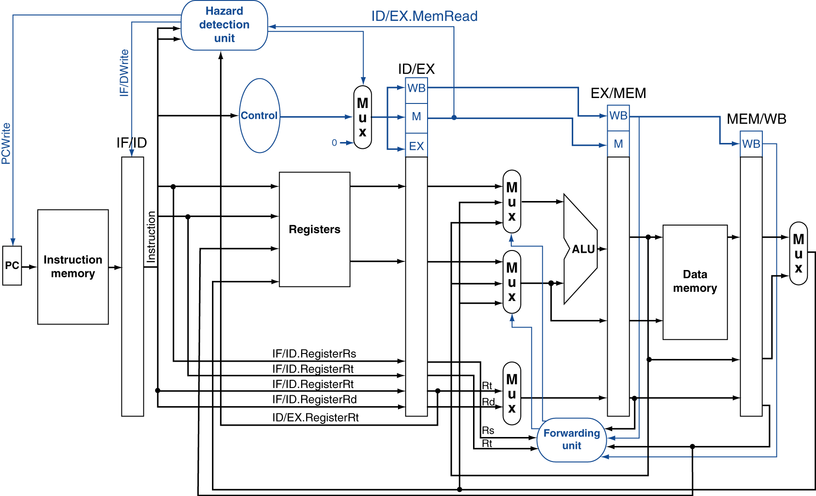
Simplified Datapath with Hazard Detection

Slide 12
Stall Details
InhibitFetch == 1 locks buffer and PC
Stall == 1 iff load-use hazard
Zeroes all control signals iff Stall == 1

Slide 13
Unsimplified Datapath with Hazard Detection
Yes:
add
sub
and
or
slt
sw
lw
No:
beq
j

